Slide 1

Exploring FOLH1 & PIP5K1A as a Context-Dependent Markers of Tumor Biology Across Cancer Types, Disease Progression and Tumor Immune Microenvironment
Practice in Bioinformatics, 15 credits
Jenny Persson Lab
Ravindu Liyanage
rasa0105@student.umu.se

Slide 2
Cohorts & Data Used
Accessing data
TCGA-PAAD (pancreatic adenocarcinoma)
Using TCGAbiolinks package in R
Downloading rds and clinical data files from cBioPortal and uploading to R using the SummrizedExperiments package
Human Cohorts Used
TCGA pan cancer
TCGA-PRAD (prostate adenocarcinoma)
SU2C 2019
(metastatic PRAD)
MSKCC 2010
(prostate adenocarcinoma)
Pancreatic tumors: PIP5K1A WT/KO with different treatments
Original tumor (female)
Syngeneic tumor (Male and female)
Experimental Mouse Model
RAW FASTA sequencing files from Novogene

Slide 3
1. Prostate Adenocarcinoma (PRAD)

Slide 4
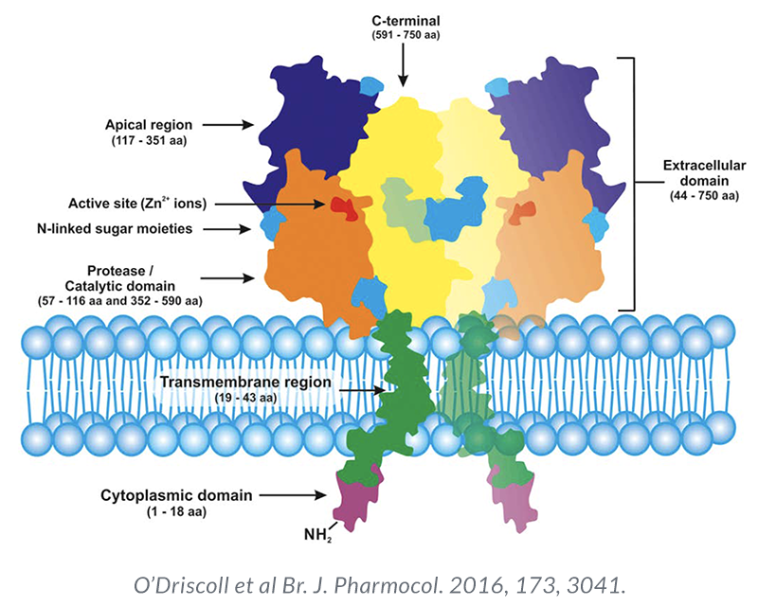
Background
Prostate cancer:
2nd most commonly diagnosed cancer 5th leading cause of cancer death in men worldwide.
PSMA:
Type II transmembrane glycoprotein encoded by FOLH1.
Highly enriched in prostate cancer compared with normal or benign tissue.
Expression generally increases with disease progression and metastasis
Can be lost in androgen-receptor–negative or neuroendocrine prostate cancer
Rationale:
To investigate whether FOLH1 expression is associated with cancer type, tumor progression and survival and microenvironmental features.

Slide 5
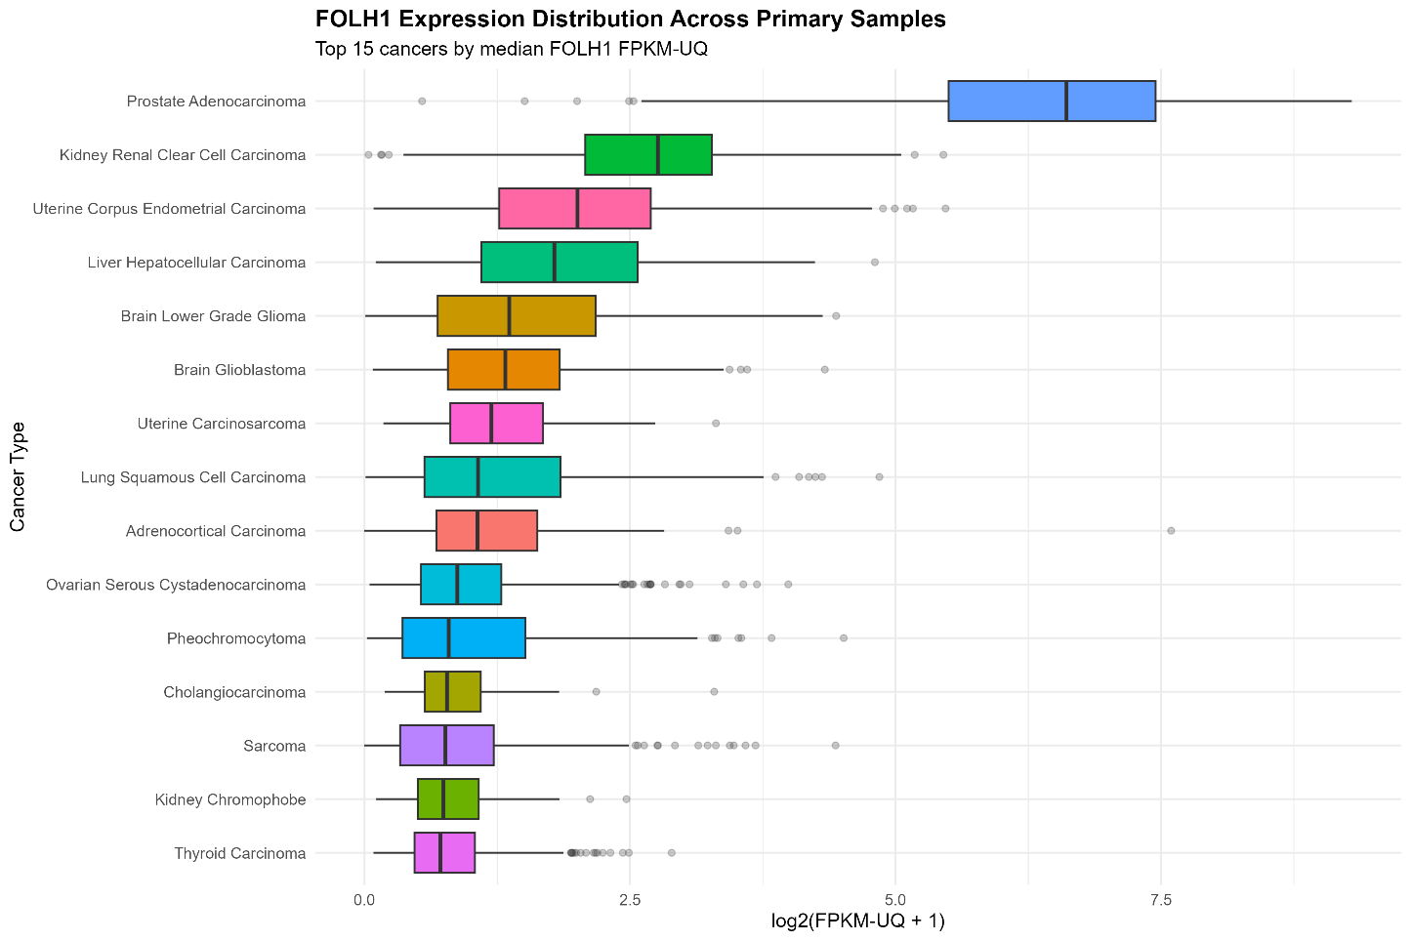
FOLH1 Across Cancer Types in TCGA Pan cancer Cohort
Overall, FOLH1 expression differed strongly across cancer types, with the group comparison reaching extreme significance (Kruskal-Wallis p < 2.2e-16)
FOLH1 showed the highest median expression in prostate adenocarcinoma.
It remained the dominant outlier and the rest of the cancers clustered at much lower expression levels.

Slide 6
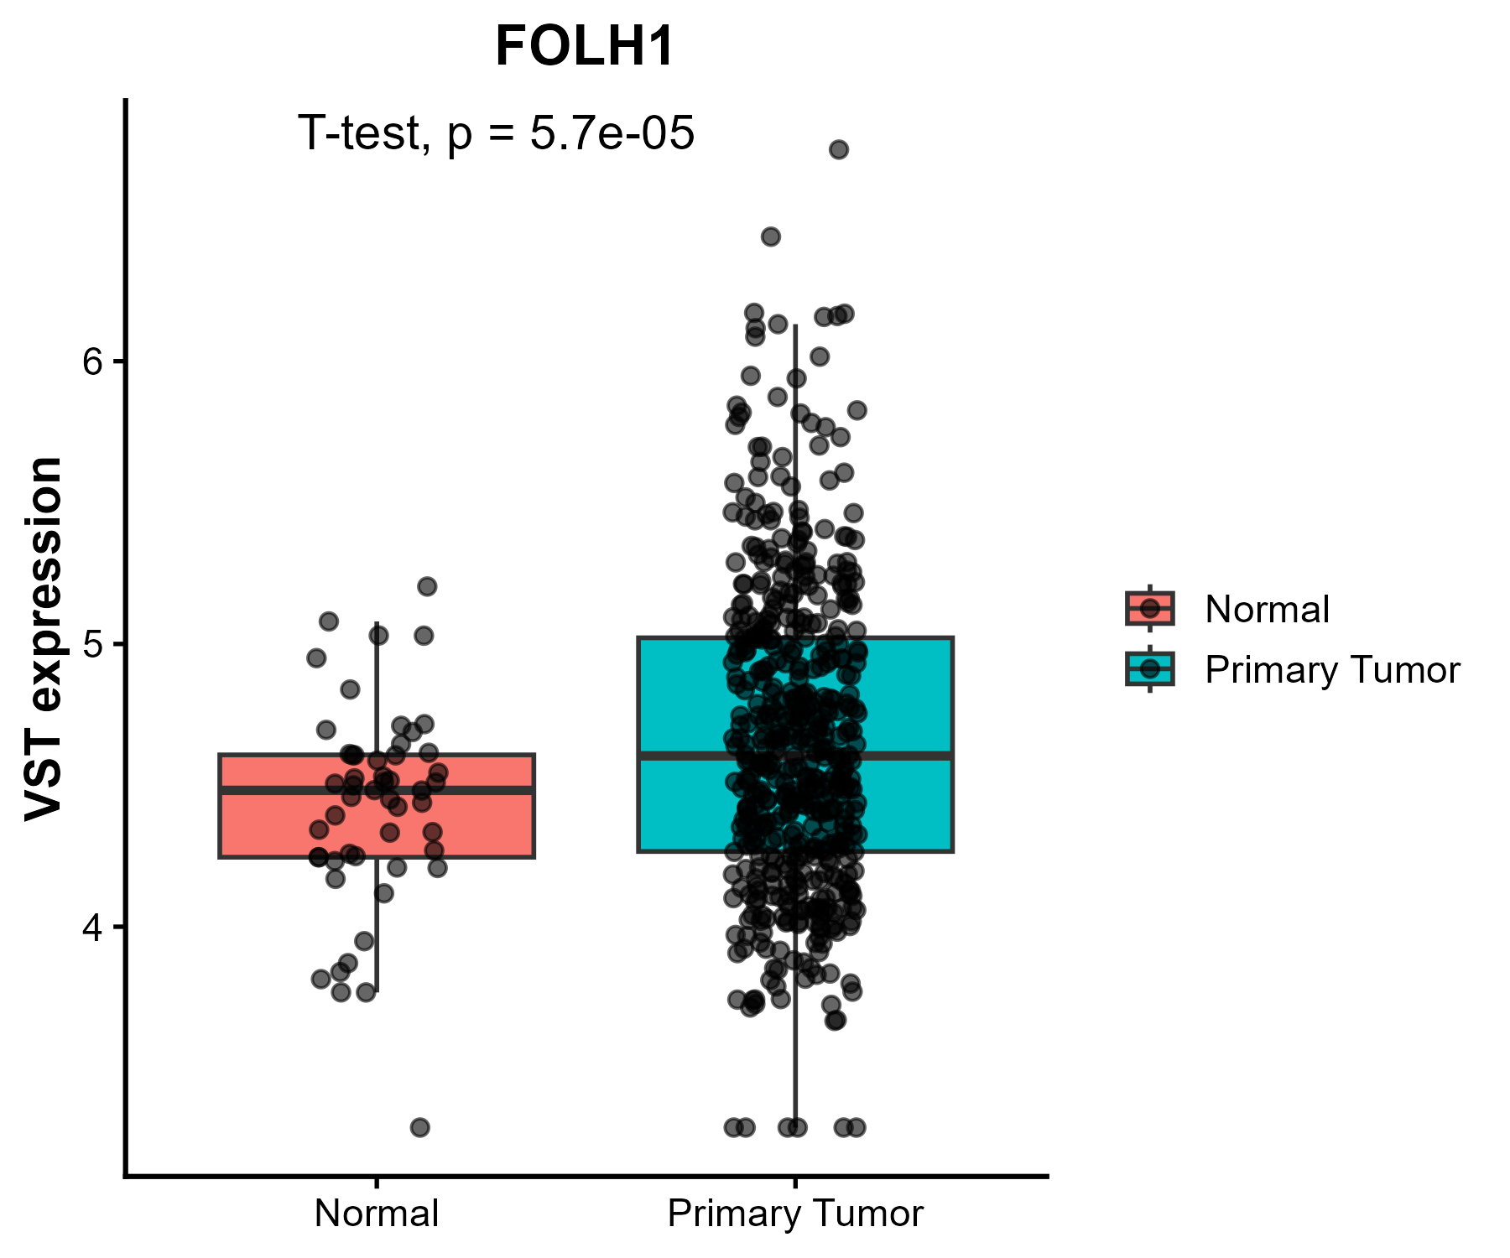
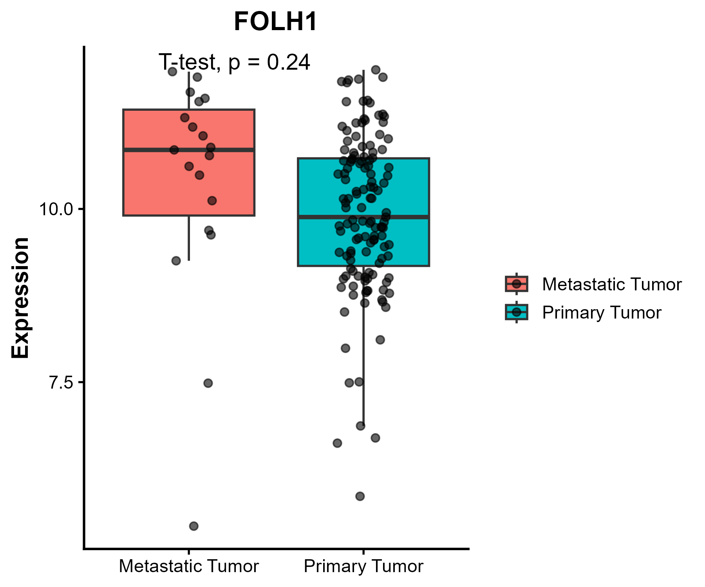
FOLH1 Expression Across Normal Solid Tissue, Primary and Metastatic tumors
Higher median FOLH1 expression in primary tumors (Two-sided t-test: 𝑝=5.7×10−5)
FOLH1 may distinguish prostate tumor tissue from normal prostate tissue in this cohort.
Metastatic tumors showed a slightly higher median FOLH1 expression than primary tumors (not statistically significant: t-test, 𝑝=0.24)

Slide 7
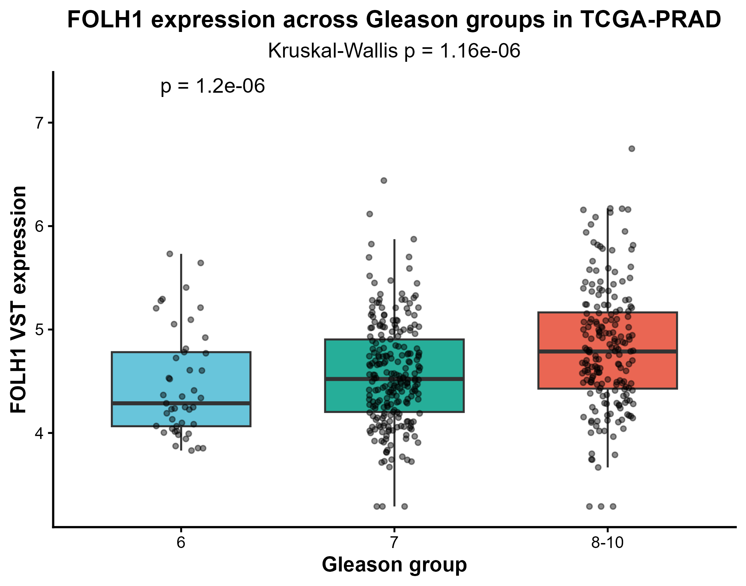
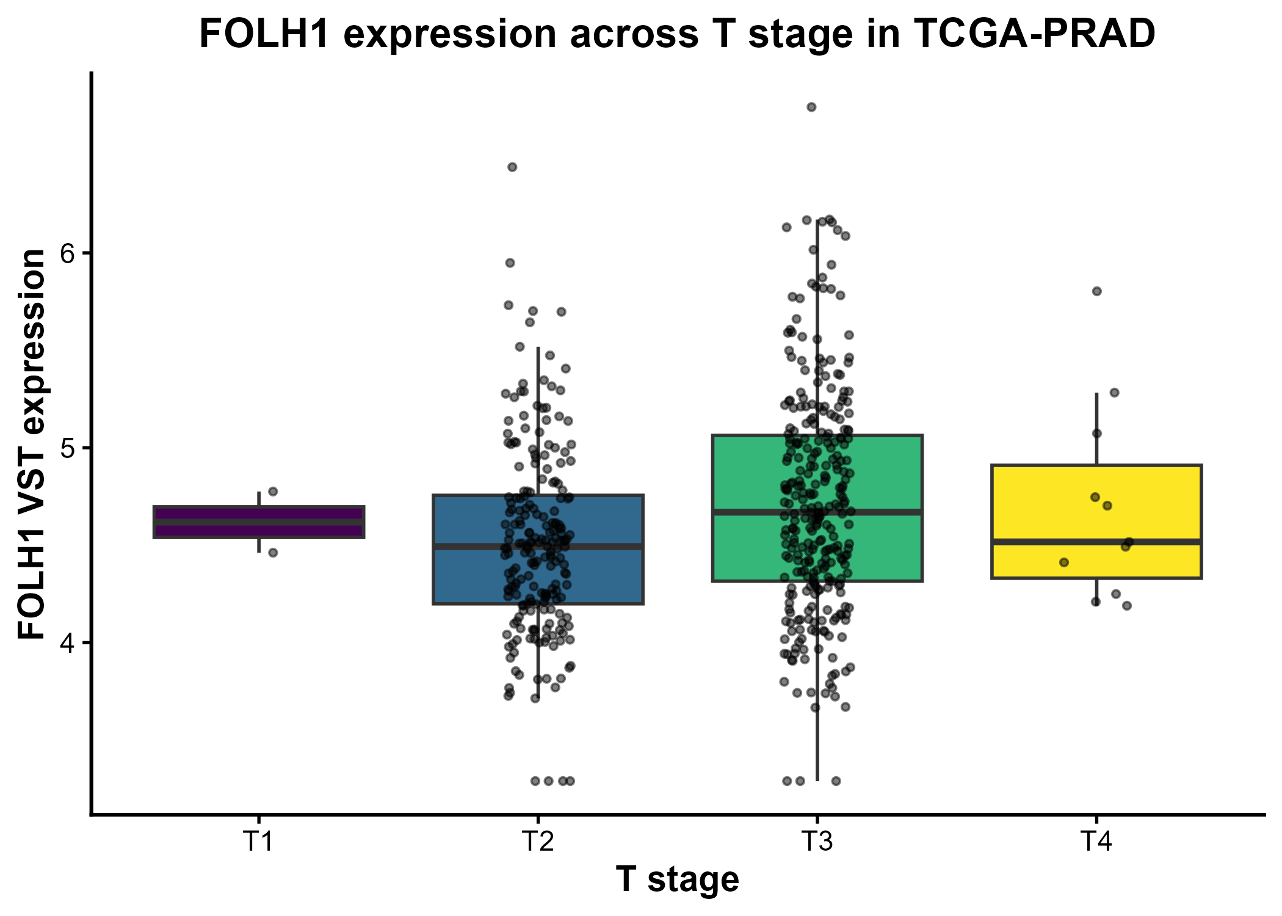
FOLH1 & Prostate Cancer Progression
FOLH1 showed a significant difference among Gleason groups in Primary tumors (p= 2.62E-06), suggesting Gleason score dependent expression differences.
FOLH1 showed a significant difference (p= 0.000392, pairwise Wilcoxon) between T2 and T3 groups, in primary tumors. Comparison across other groups were not statistically significant.

Slide 8
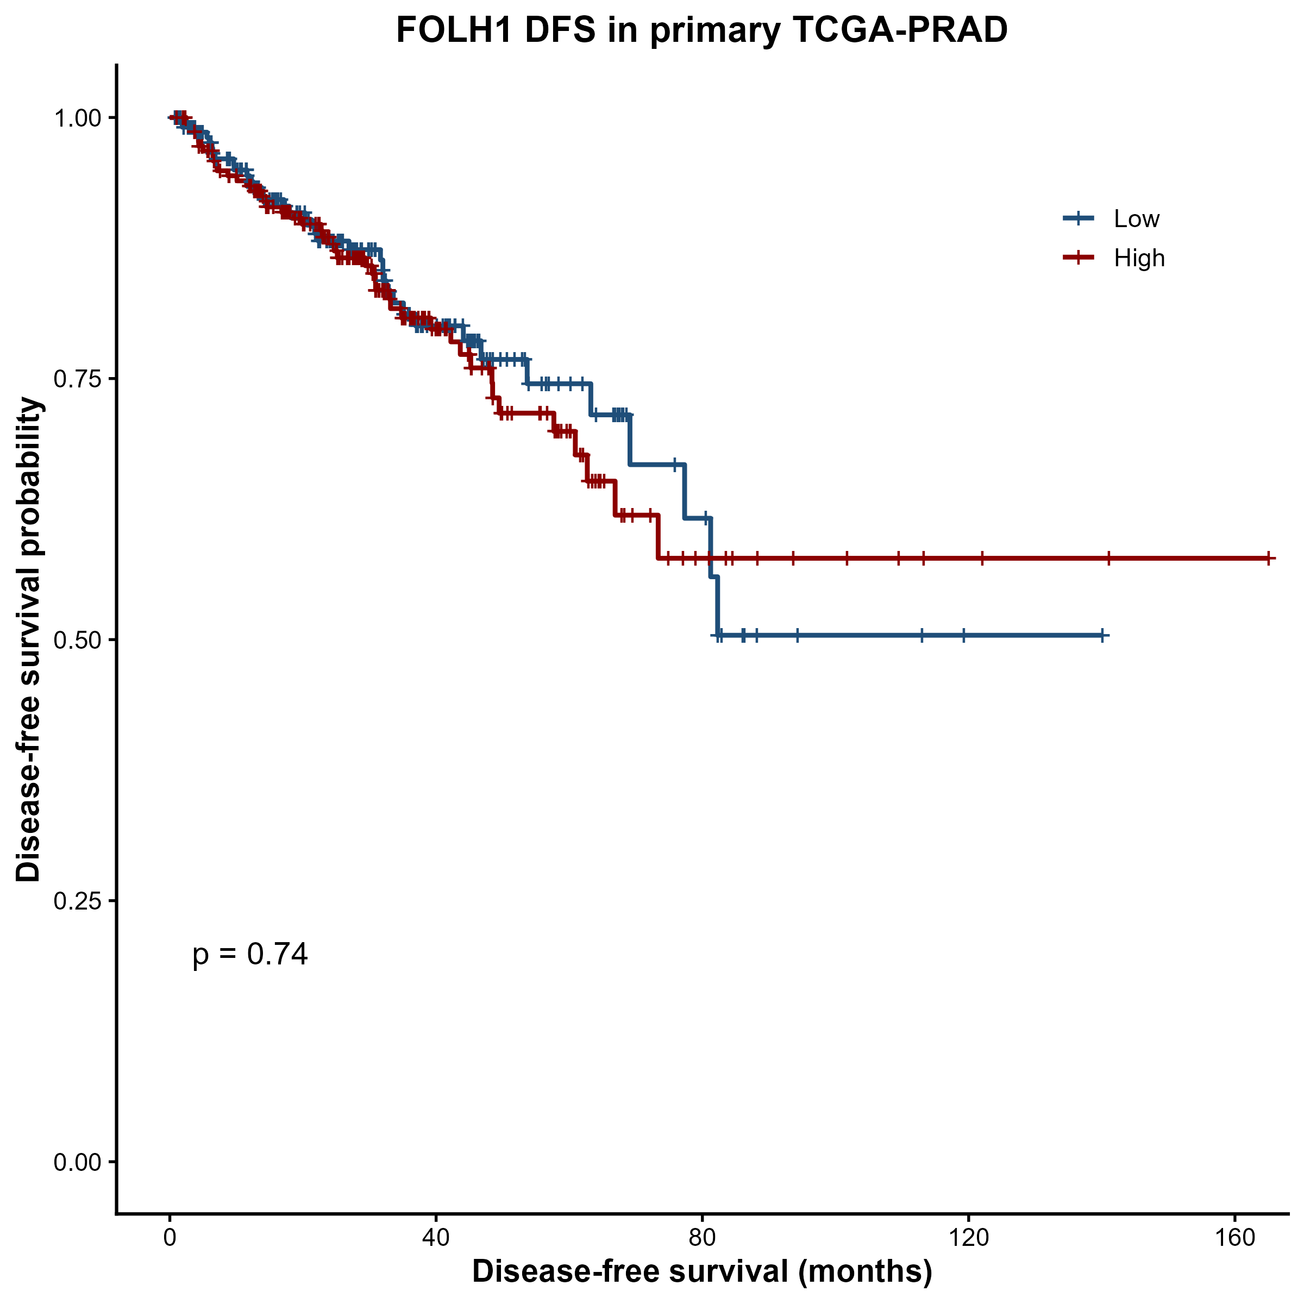
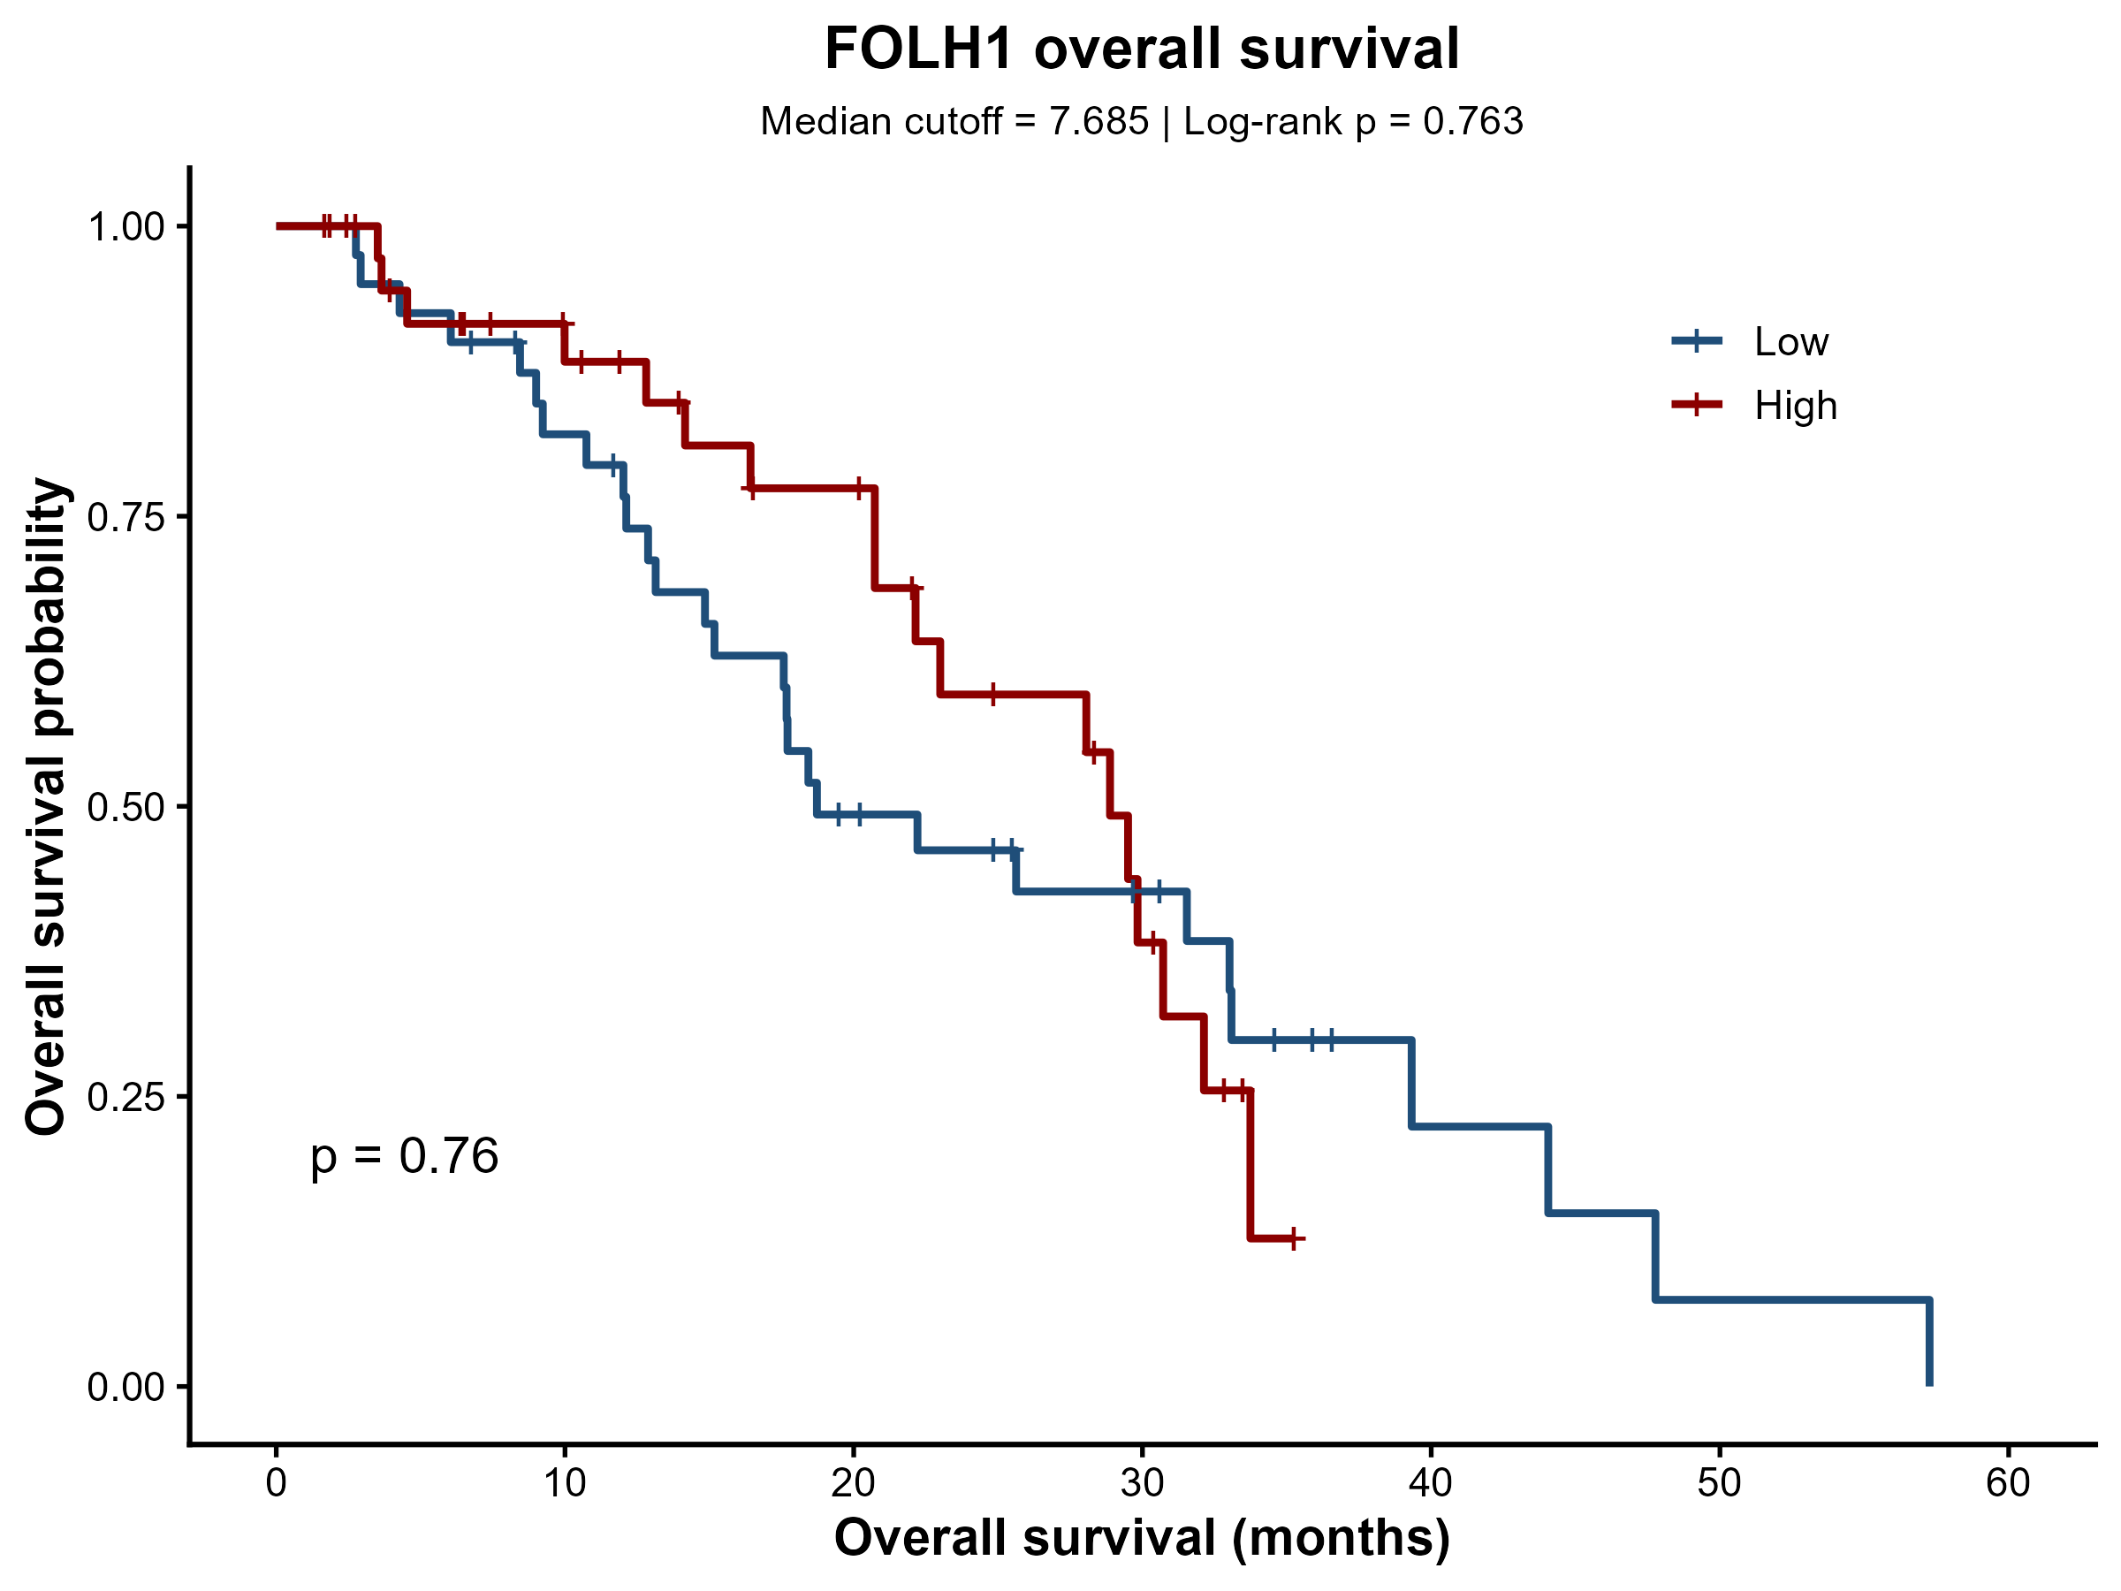
Survival Study on Primary and Metastatic Tumor Patients With Respect to FOLH1 Expression Levels
No significant difference was observed in DFS between the two groups
FOLH1 expression alone did not demonstrate prognostic value for survival stratification

Slide 9
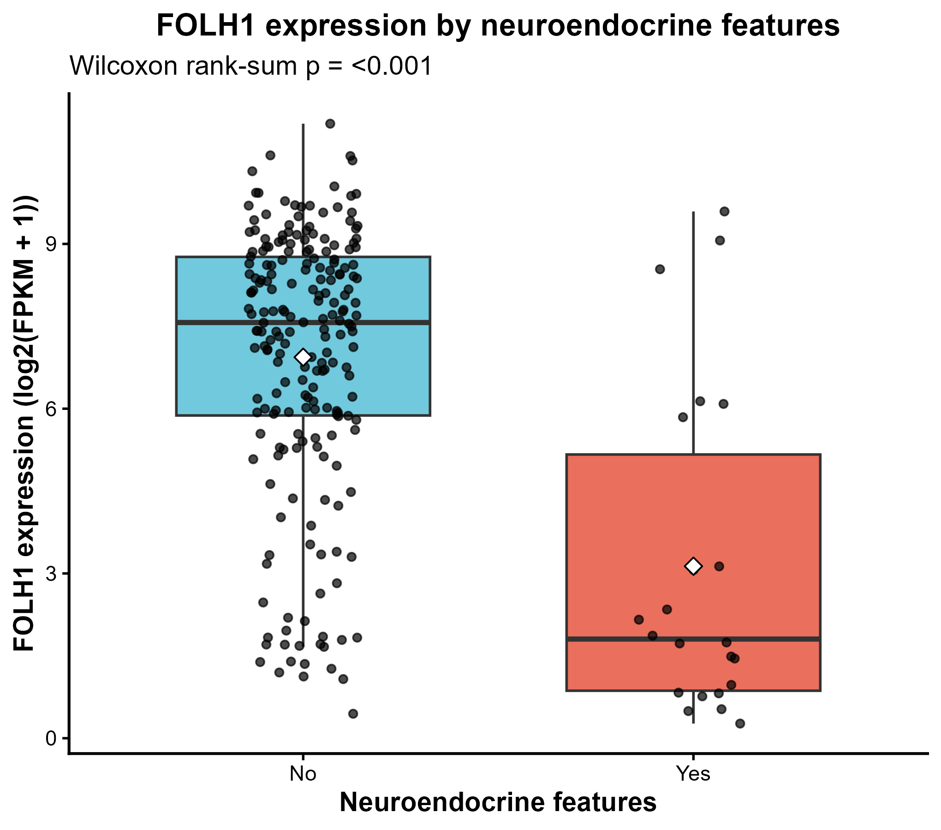
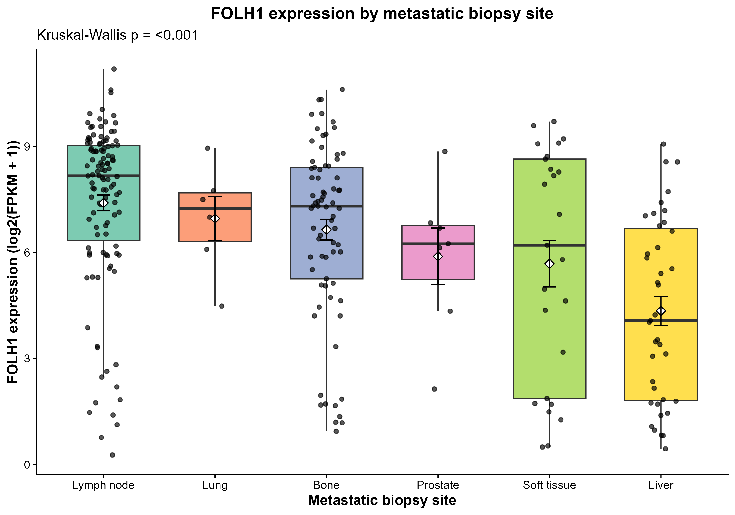
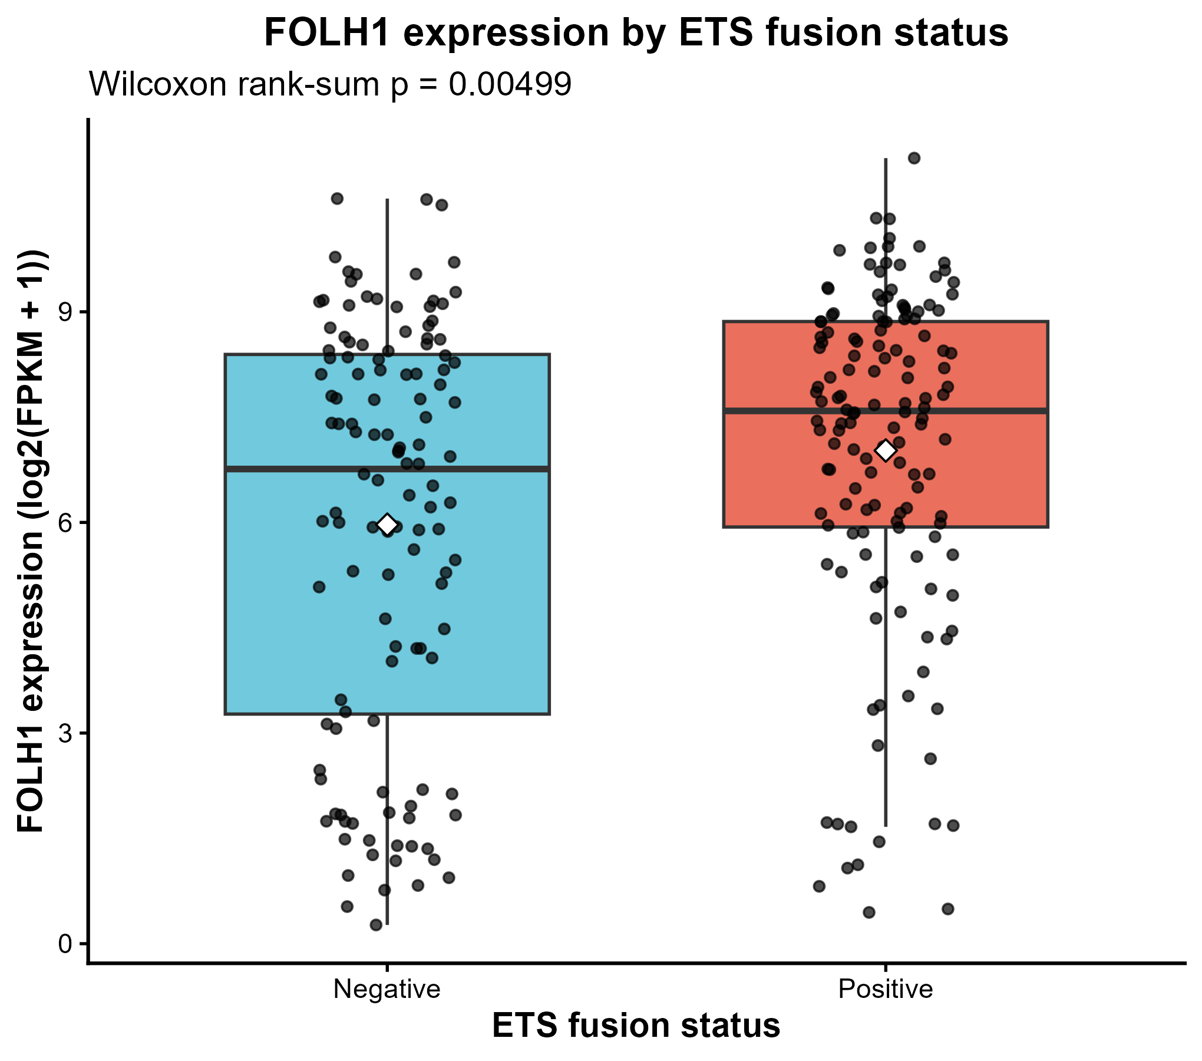
Metastases Specific Analysis
FOLH1 expression was significantly lower in feature-positive tumors.
Wilcoxon p < 0.001
Aligns with recent publications.
FOLH1 expression was significantly higher in ETS fusion-positive tumors.
Wilcoxon 𝑝=0.00499.
FOLH1 expression differed significantly between metastatic biopsy sites (Kruskal–Wallis p=<0.001).
Highest in lymph-node and bone metastases.
Lowest in liver metastases.
Pairwise testing identified significant differences between lymph node and liver (adj = 1.12×10−8) and between bone and liver (𝑝 adj = 0.000613)

Slide 10
Correlation for Primary and Metastatic tumors with known biomarkers of PRAD
Biomarkers | Type of biomarker | Gene name equivalent
AURKA | Gene
BRCA1
BRCA2
MYC
TP53
PTEN
RB1 (neuroendocrine)
TTF1
INSM1 (neuroendocrine)
NKX2-1 (neuroendocrine)
PAP | Protein | ACP3
Chromogranin A (neuroendocrine) |  | CHGA
Chromogranin B (neuroendocrine) |  | CHGB
CD71 |  | TFRC
CD56 (neuroendocrine) |  | NCAM1
Secretogranin II (neuroendocrine) |  | SCG2
Synaptophysin (neuroendocrine) |  | SYP
Well established prostate cancer biomarkers
New emerging prospective biomarkers from recent publications
Neuroendocrine biomarkers

Slide 11
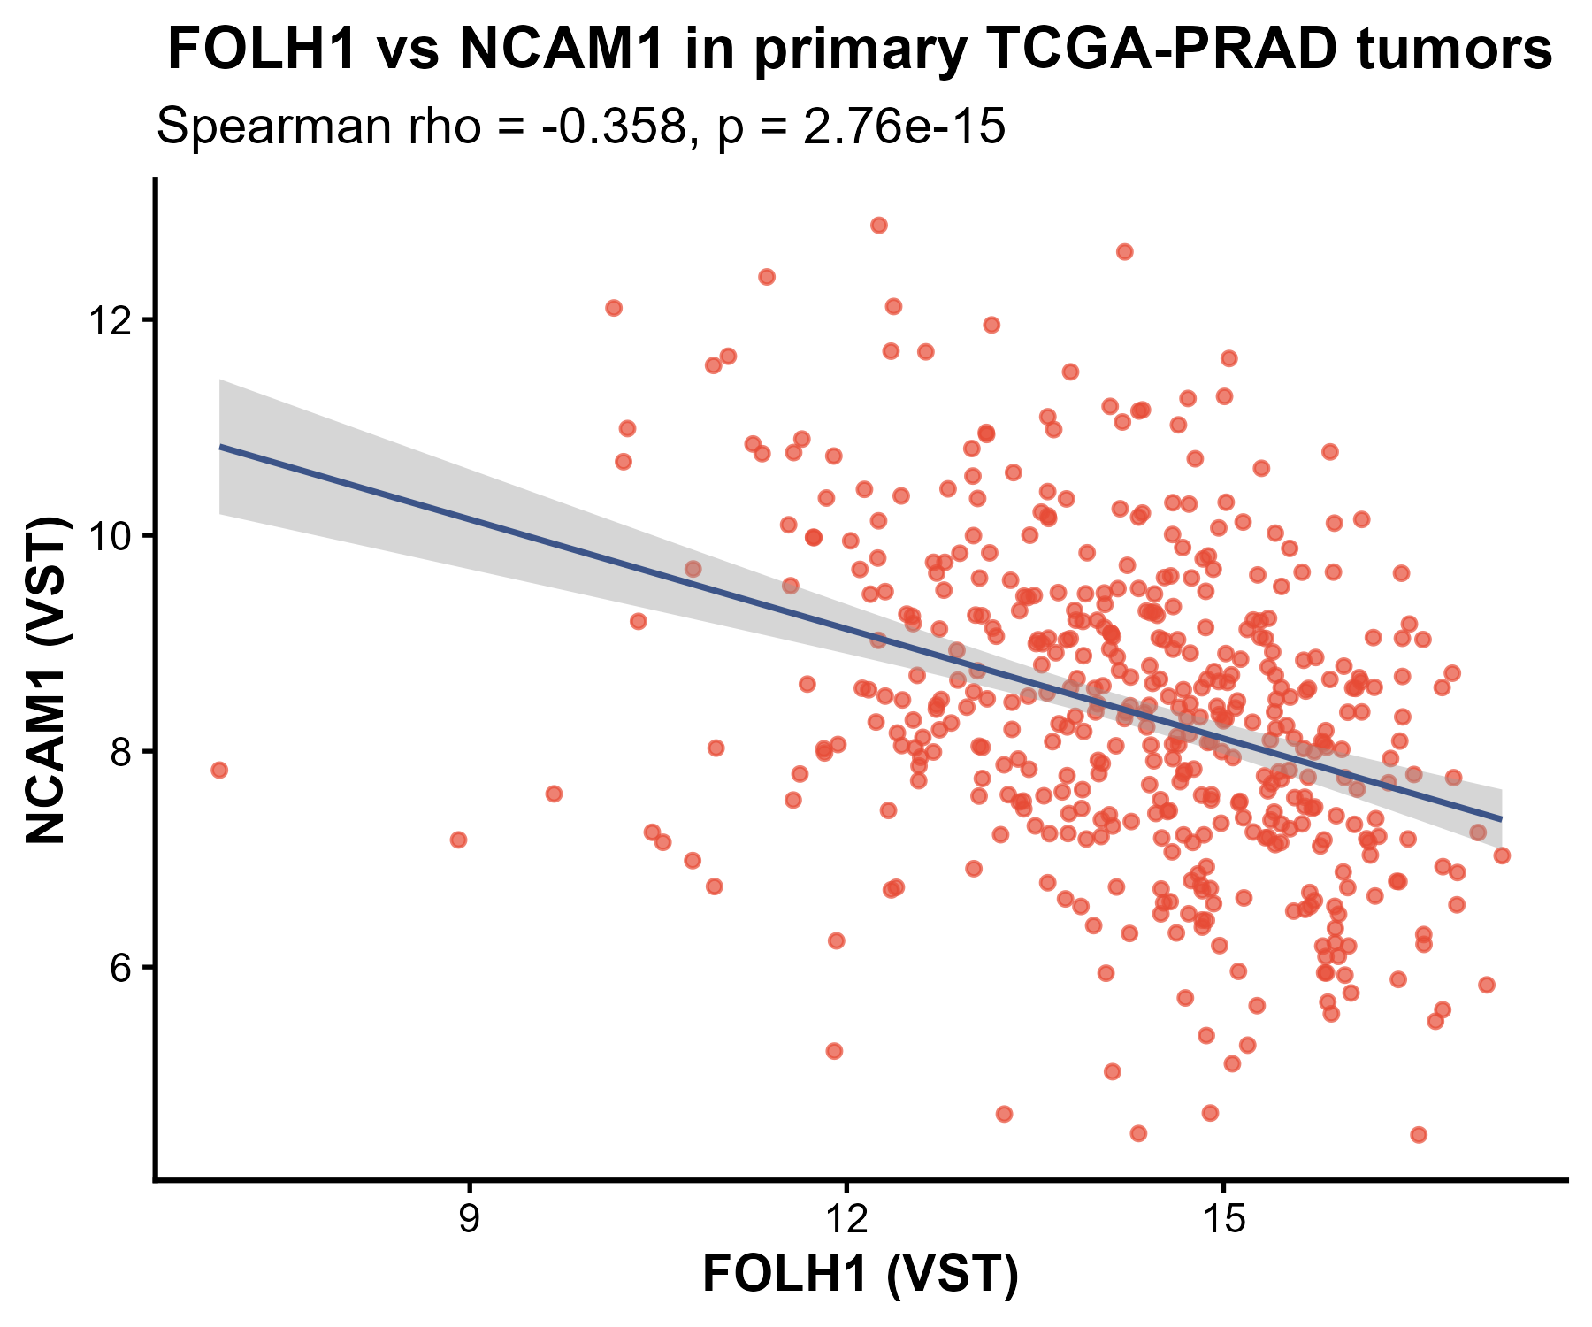
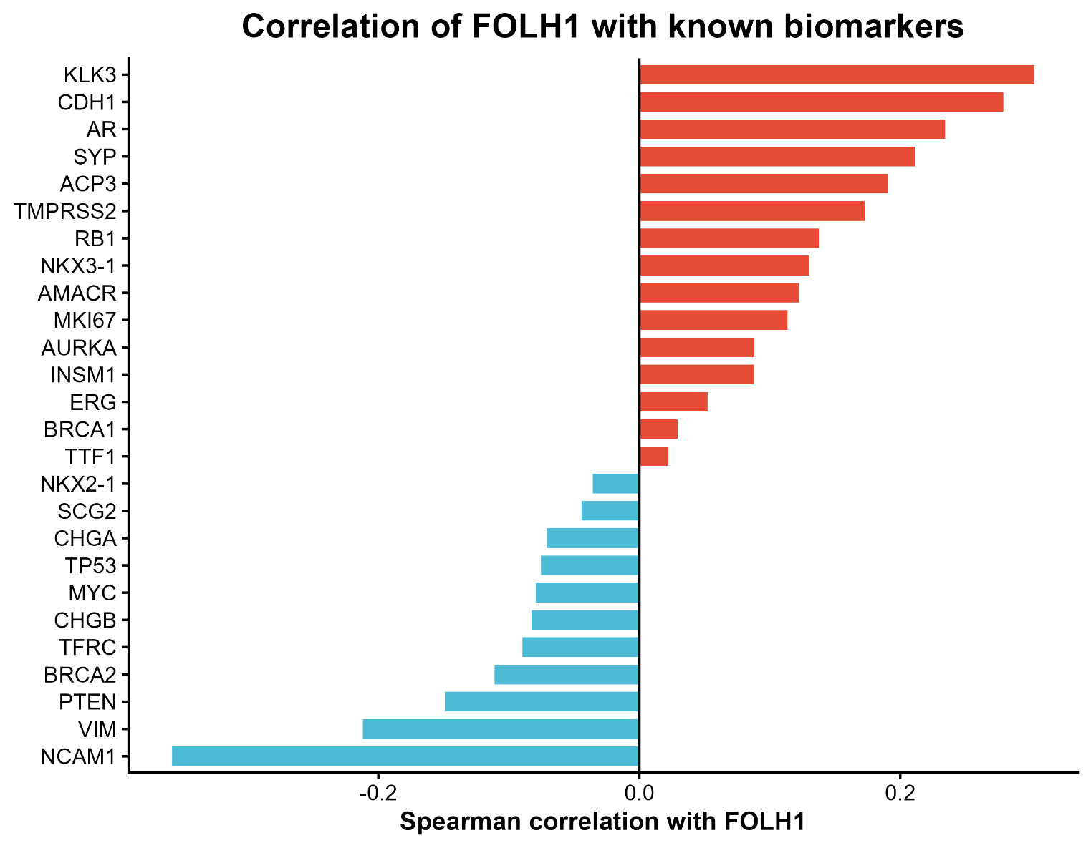
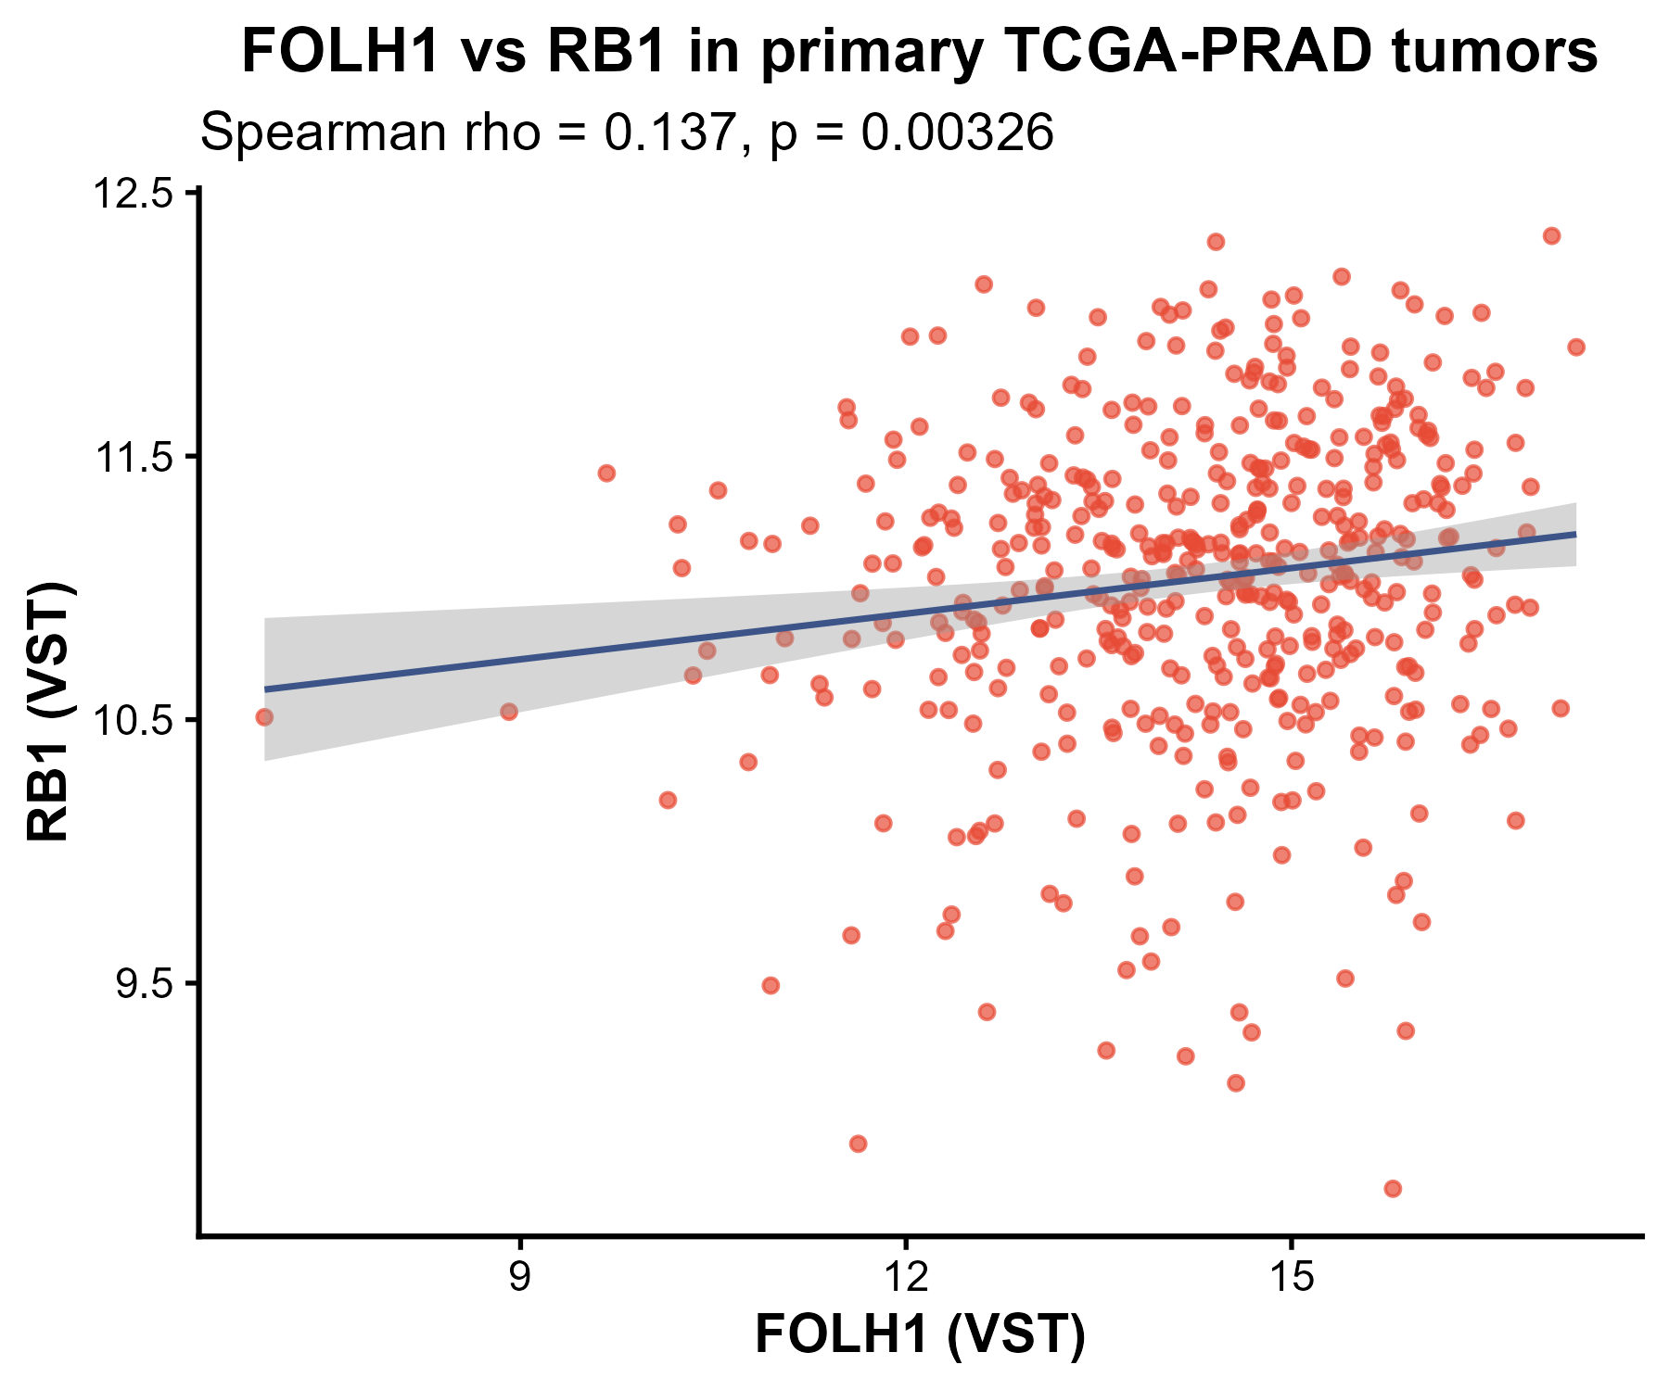
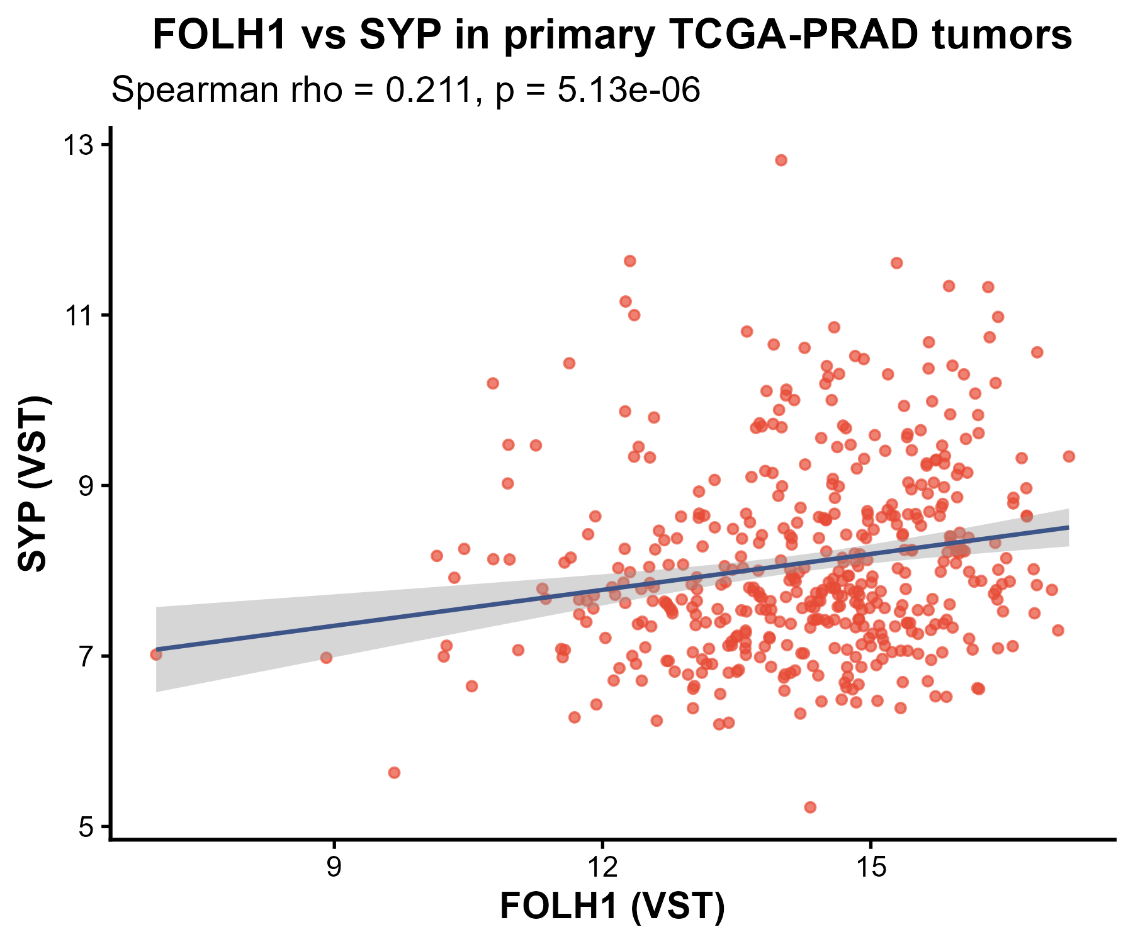
Correlation for Primary tumors with known biomarkers of PRAD
CD56, RB1 and Synaptophysin showed statistically significant Correlation with FOLH1

Slide 12
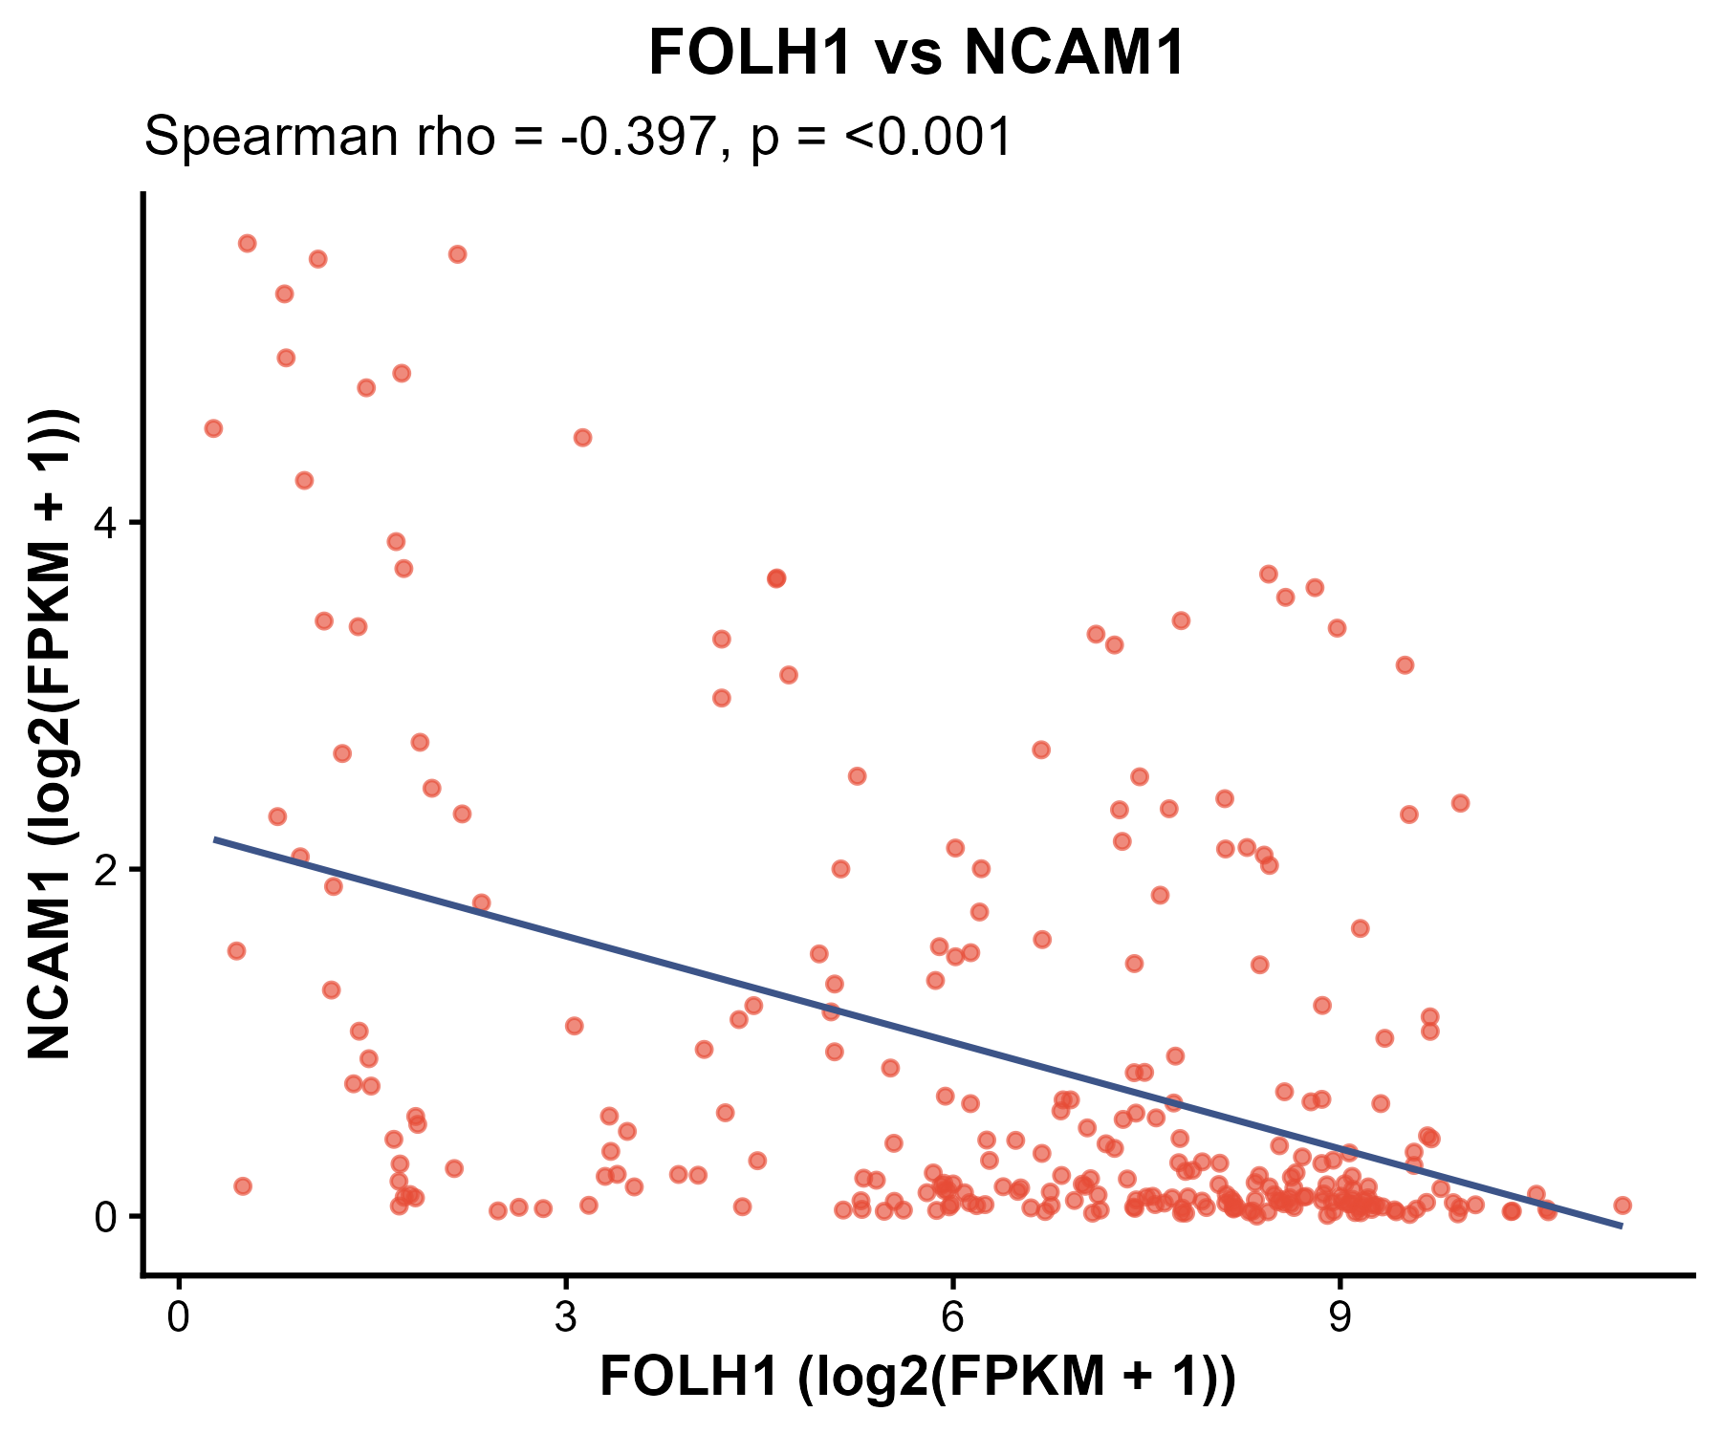
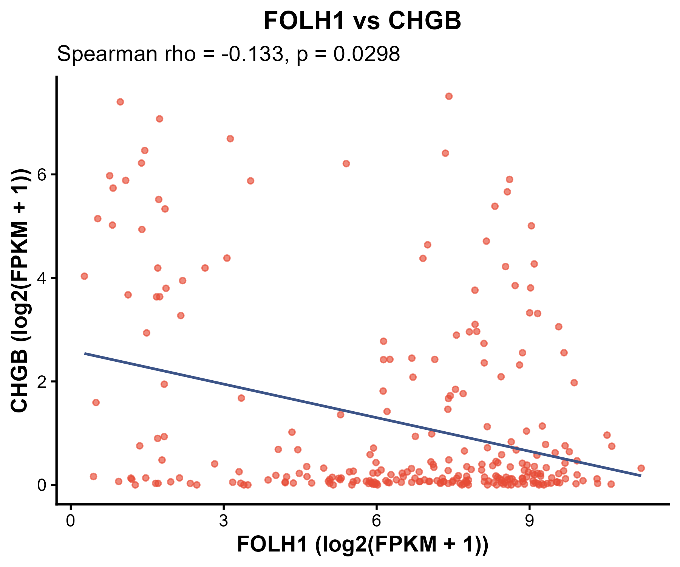
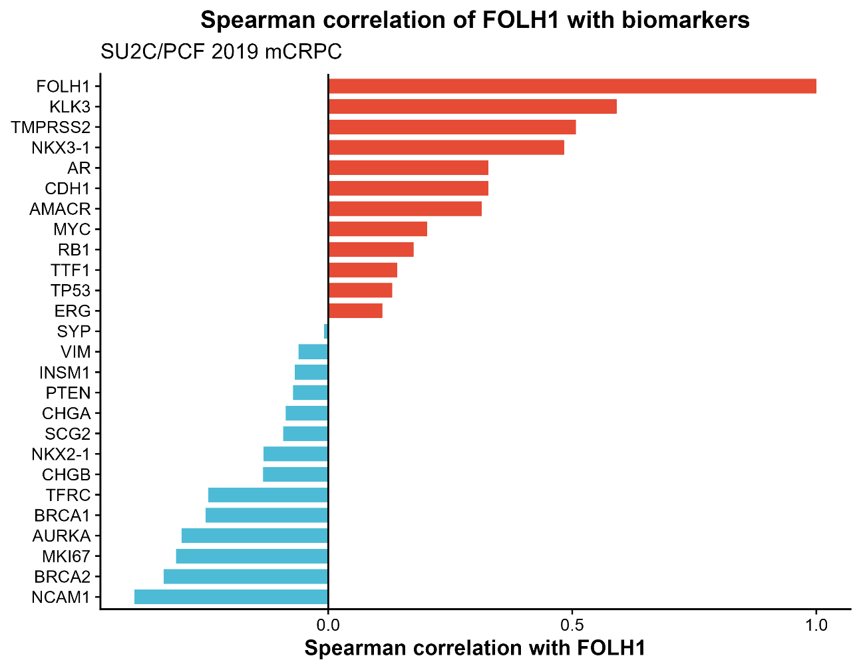
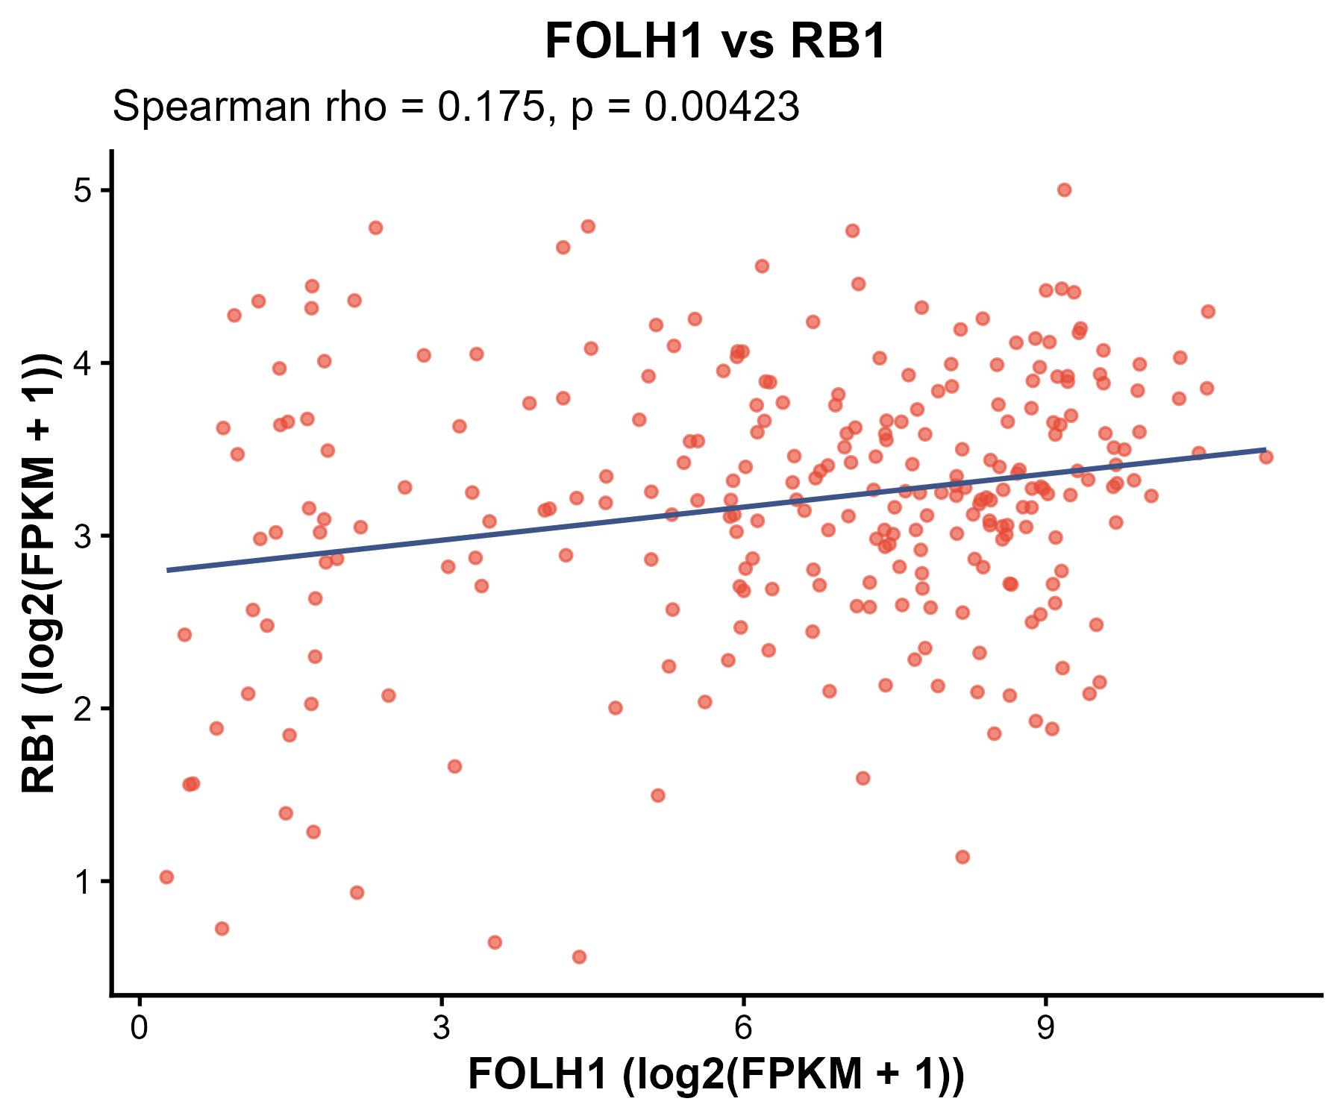
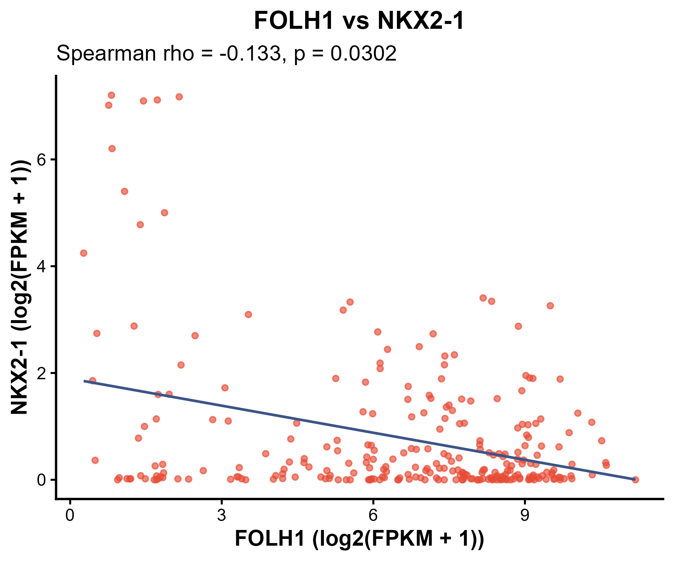
Correlation for Metastatic tumors with known biomarkers of PRAD
CD56, Chromogranin B, RB1 and NKX2-1 showed statistically significant Correlation with FOLH1

Slide 13
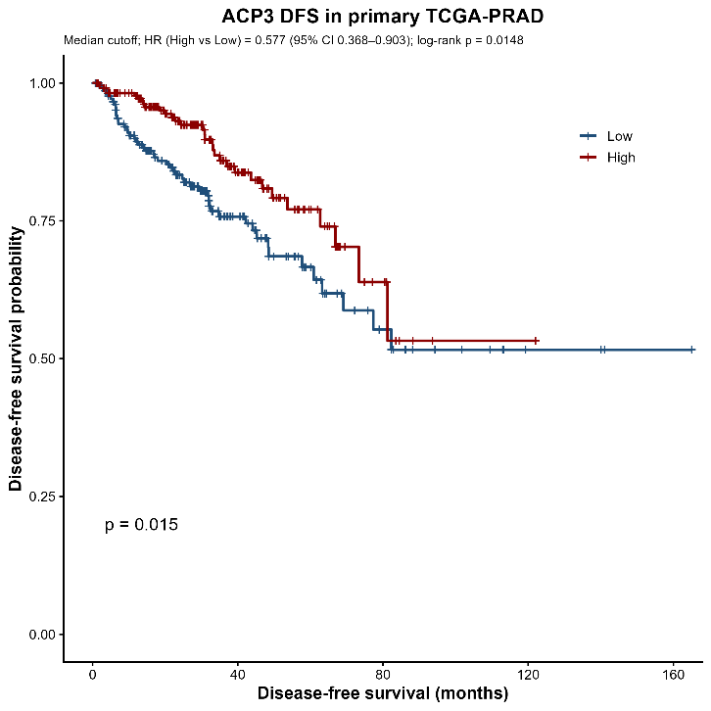
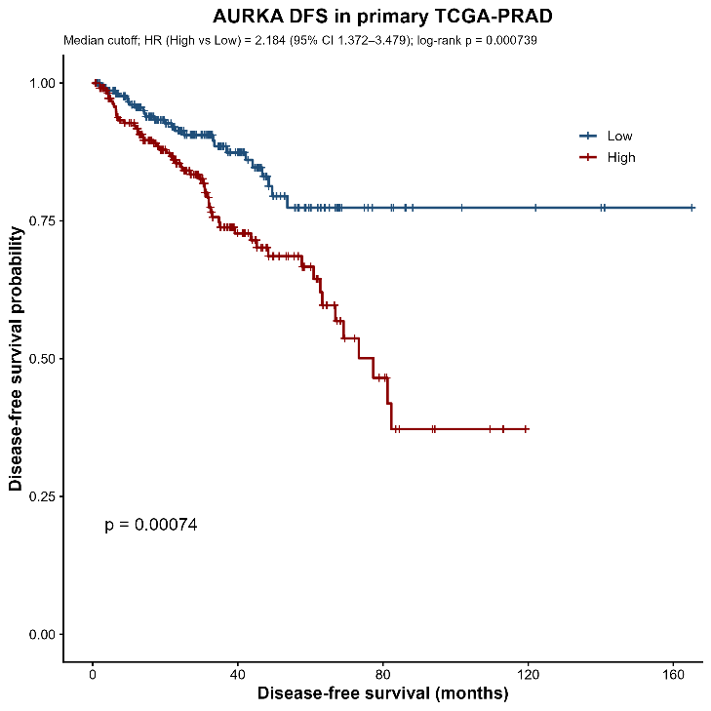
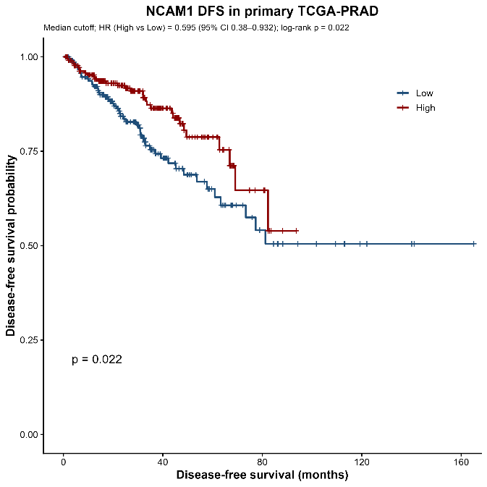
Biomarkers with DFS separation in Primary Tumor
ACP3, AURKA and NCAM1 showed significant DFS separation.
AURKA displayed the strongest association. high expression -> shorter DFS.
NCAM1 was the only neuroendocrine marker from the list that showed DFS separation.

Slide 14
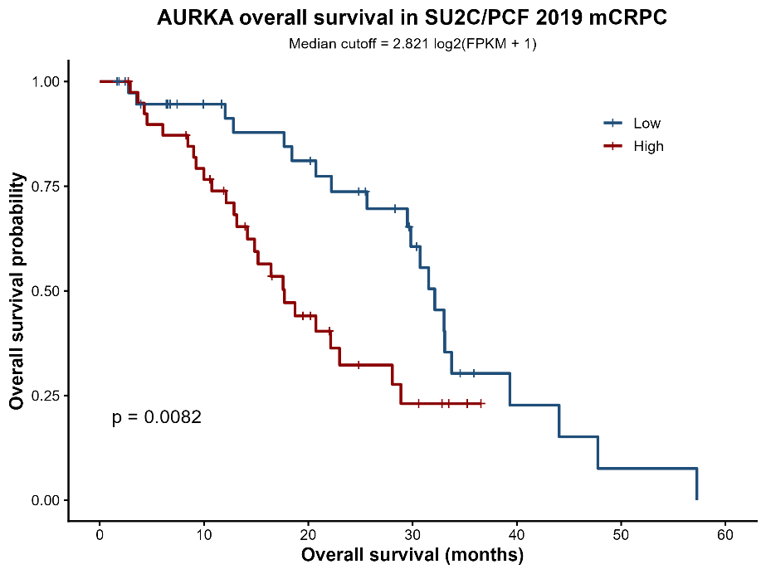
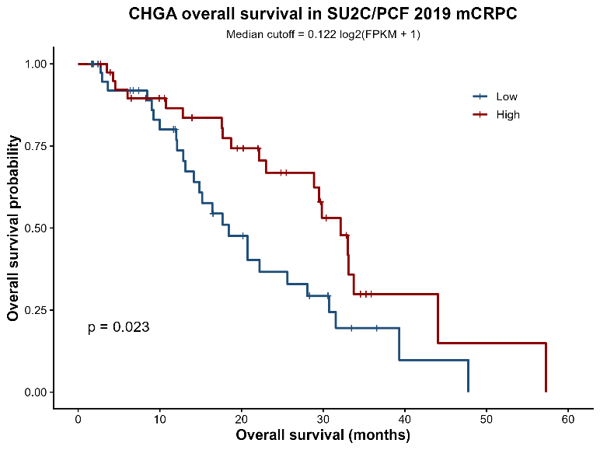
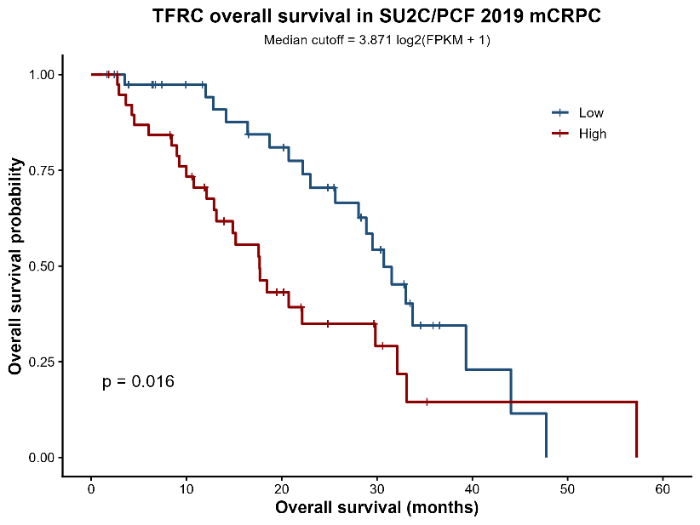
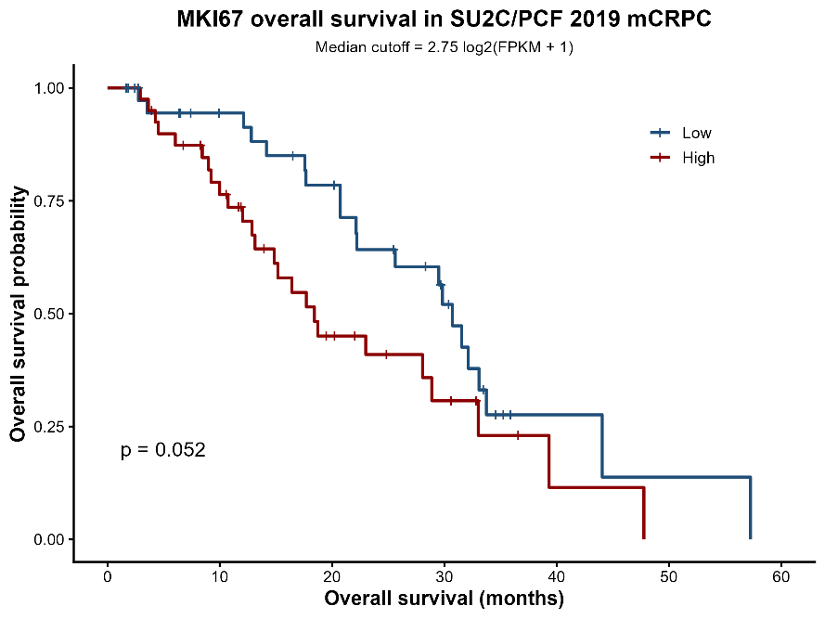
Biomarkers With DFS Separation in Metastatic Tumor
AURKA, CHGA, TFRC and MKI67 showed significant DFS separation in metastatic tumors of the SU2C cohort.
Again, AURKA displayed the strongest association, with high expression linked to shorter disease-free survival.
Chromogranin A was the only neuroendocrine marker from the list that showed DFS separation in metastases.

Slide 15
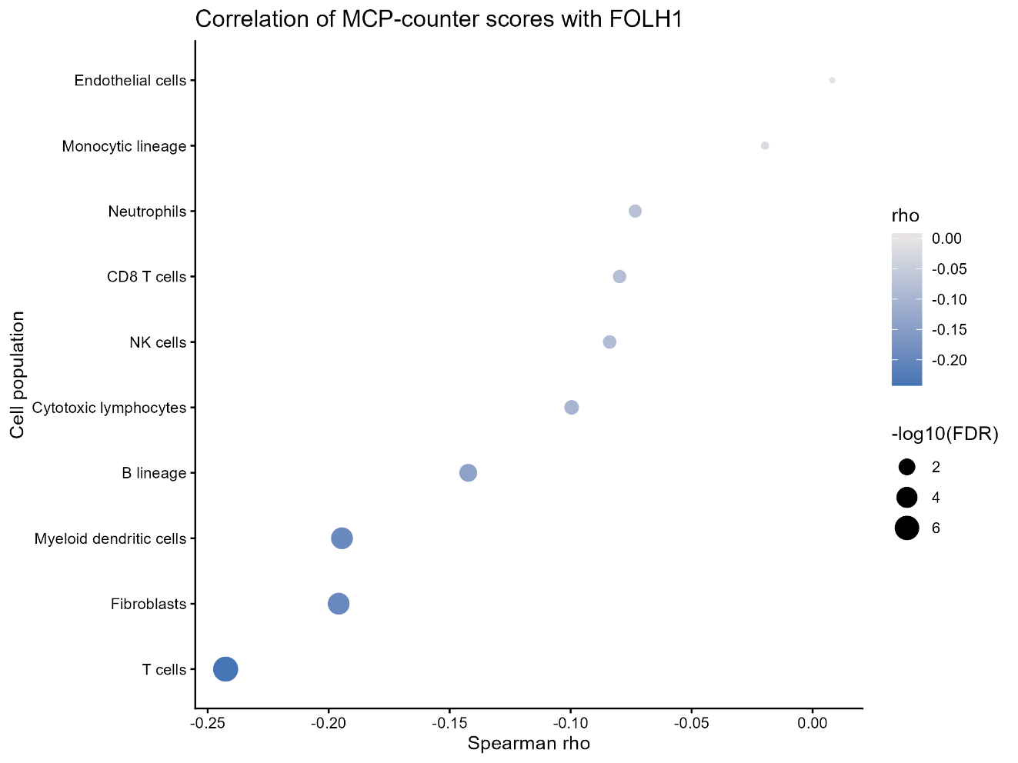
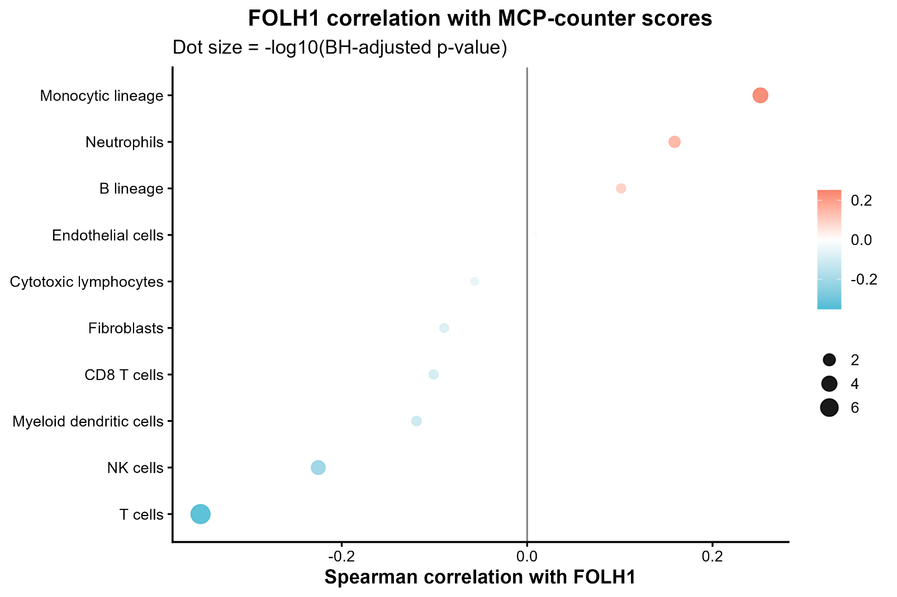
FOLH1 correlation with MCP-Counter Scores
Primary tumors
Metastatic tumors
Primary tumors showed mainly negative correlations, whereas metastatic tumors showed positive associations with monocytes, neutrophils and B-lineage cells. T-cell scores were negatively associated with FOLH1 in both settings.

Slide 16
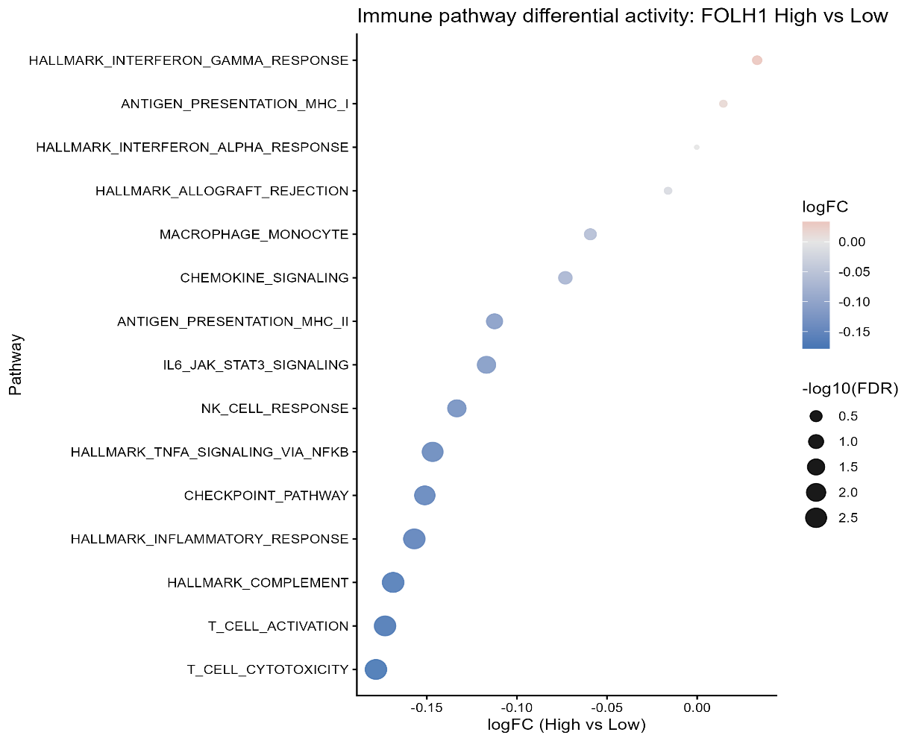
Immune Pathway Activity Associated with FOLH1 Expression in TCGA PRAD
Median FOLH1 expression: High and Low
GSVA used to compute immune pathway activity per sample
FOLH1-high tumors exhibited significantly lower activity of several immune-related pathways, including
T-cell activation,
cytotoxicity,
checkpoint signaling,
complement,
inflammatory signaling.
Notes:
These findings suggest that higher FOLH1 expression is associated with a less immune-inflamed tumor microenvironment.

Slide 17
Conclusions for PRAD
FOLH1- Prostate adenocarcinoma
Highly enriched in PRAD
Associated with disease features, metastatic site, and neuroendocrine-related markers
Linked to reduced immune pathway activity
Not a significant standalone DFS marker
Limitations: retrospective cohorts, heterogeneous datasets, multiple testing, and limited experimental sample sizes

Slide 18
2. Pancreatic Adenocarcinoma (PAAD)

Slide 19
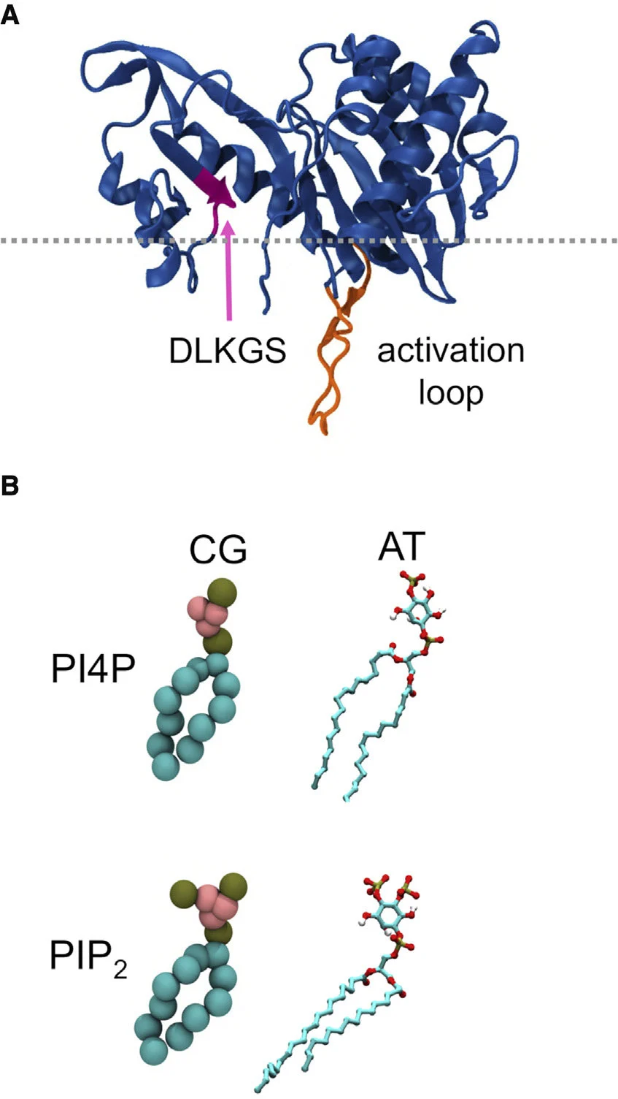
Background
Pancreatic cancer:
12th most commonly diagnosed cancer 6th leading cause of cancer death worldwide.
PIP5K1A:
Lipid kinase that produces PIP2, a key membrane-signaling molecule.
Functions upstream of the PI3K–AKT pathway, which regulates tumor-cell growth, survival and metabolism.
Interacts with oncogenic KRAS signaling and may support proliferation in KRAS-driven pancreatic cancer.
Figure: Amos, S-BTA & Kalli, Antreas & Shi, Jiye & Sansom, MSP. (2019). Membrane Recognition and Binding by the Phosphatidylinositol Phosphate Kinase PIP5K1A: A Multiscale Simulation Study. Structure. 27. 10.1016/j.str.2019.05.004

Slide 20
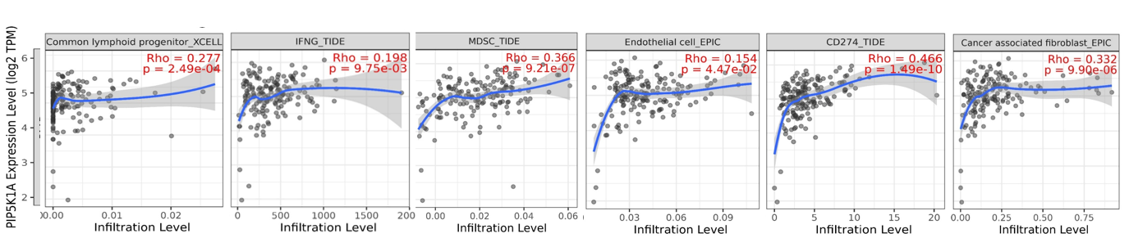
PIP5K1A correlation with immune infiltrates in Pancreatic Adenocarcinoma
Analysis done on TIMER3 webtool by compbio.
The Following Immune Infiltrate groups showed statistically significant correlation with PIP5K1A expression levels:
Common lymphoid progenitors
interferon gamma
myeloid derived suppressor cells
tumour CD274
endothelial cells
cancer associated fibroblasts

Slide 21
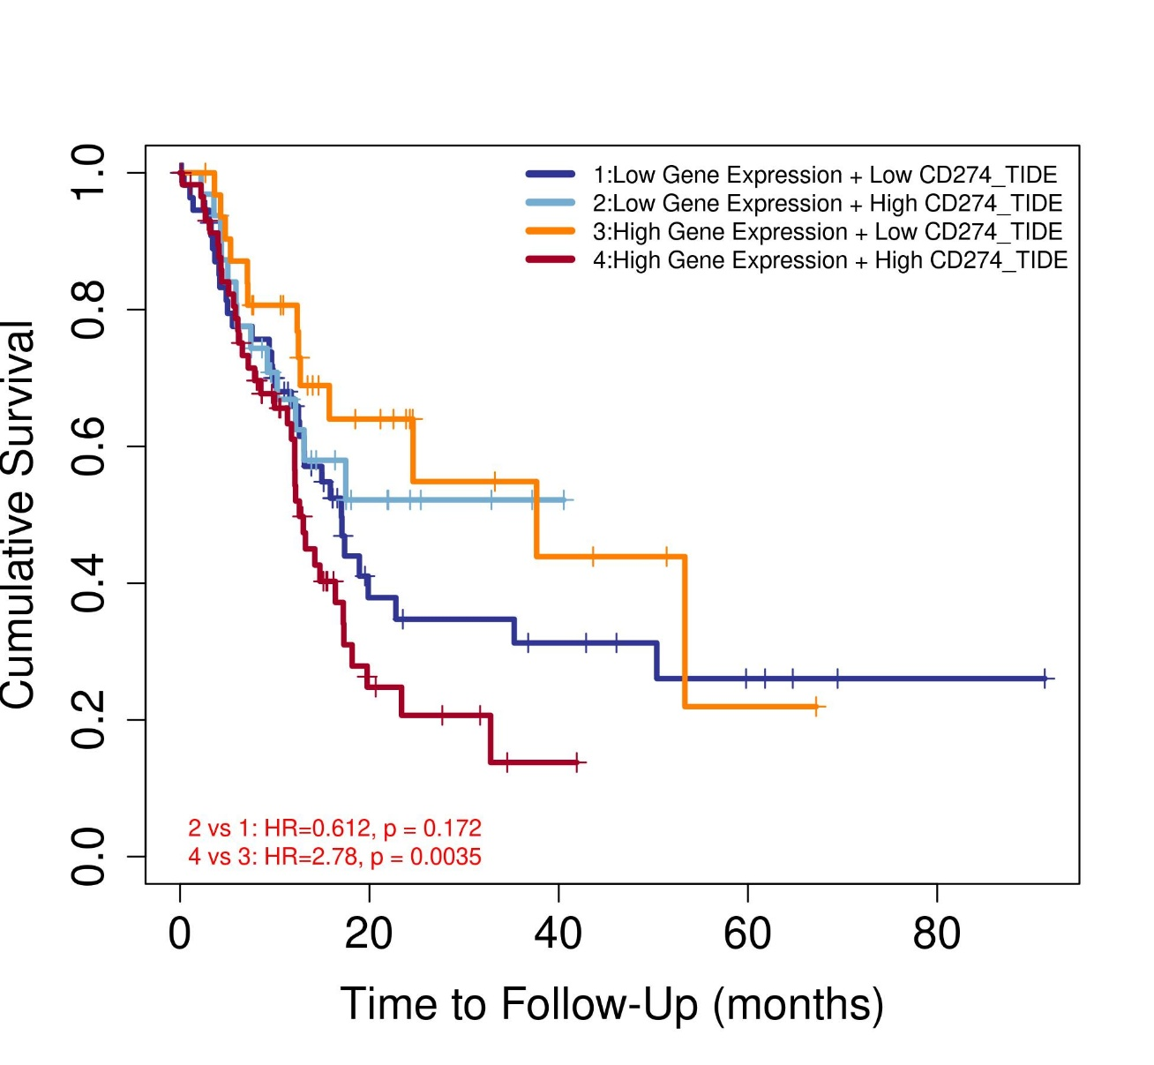
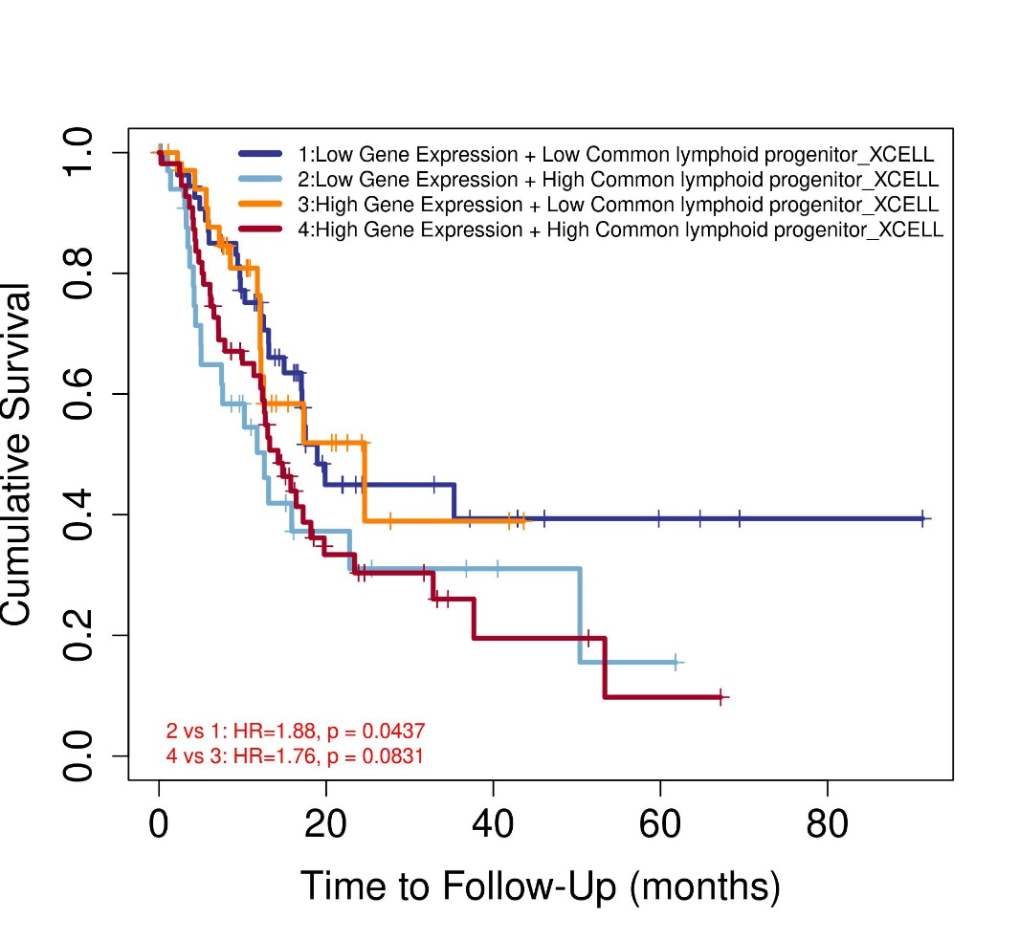
PFS Study of PIP5K1A Expression with Immune Infiltrates in TCGA-PAAD
The Progression Free Survival (PFS) study was also done on TIMER3 webtool by compbio.
Groups created:
Low PIP5K1A expression + low immune infiltrate
Low PIP5K1A expression + high immune infiltrate
High PIP5K1A expression + low immune infiltrate
High PIP5K1A expression + high immune infiltrate
Median cut-off used
The following groups showed statistically significant increased risk:
High PIP5K1A + High CD274
Low PIP5K1A + High common lymphoid progenitor

Slide 22
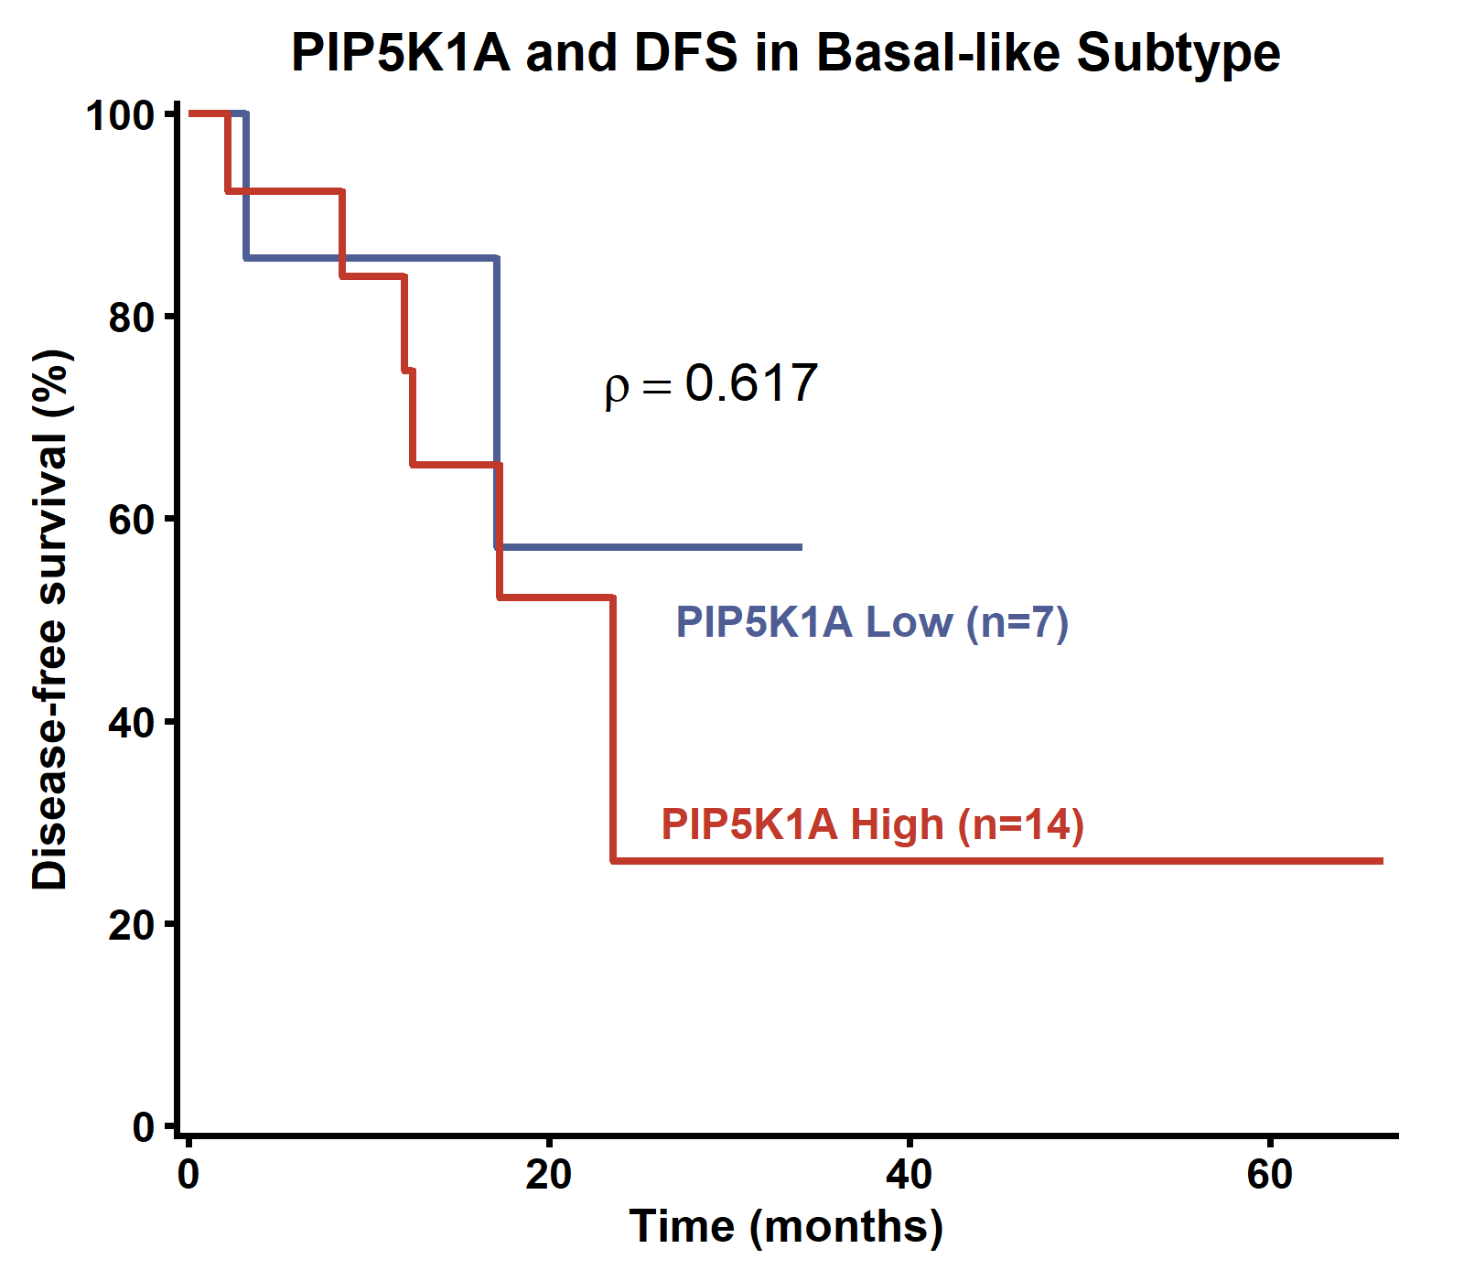
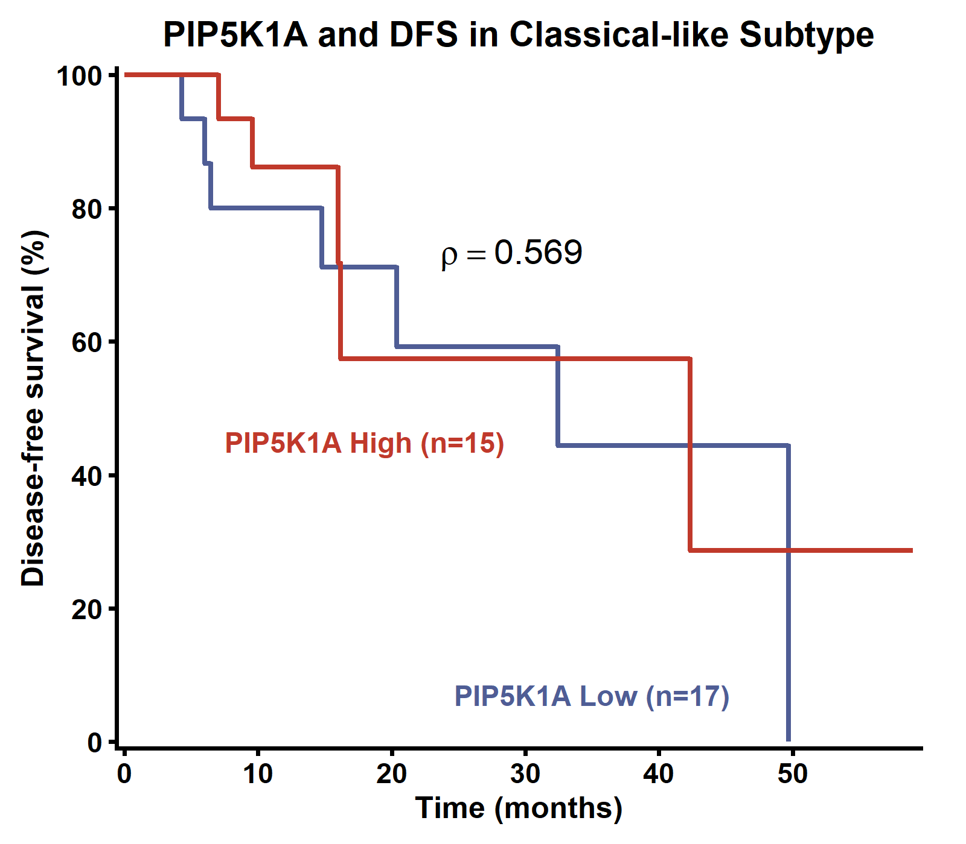
PIP5K1A association with DFS in classical-like and basal-like subtypes of PAAD
Visual differences were observed
Neither subtype comparison was statistically significant
does not support a prognostic effect of PIP5K1A on DFS in this cohort

Slide 23
3. Mouse Models with Pancreatic Adenocarcinoma

Slide 24

RNA-Seq Workflow
Raw paired-end reads
paired collections in Galaxy
Quality control
Trimming tool
RNA-STAR alignment Tool
BAM files
FeatureCounts Tool
Column join tool to create matrix
Tabular count files
Experimental Designs
Original tumor samples
PINK1-OE treatment
MTK treatment MTK treatment (two flanks)
ISA treatment
GTF mouse annotation file

Slide 25
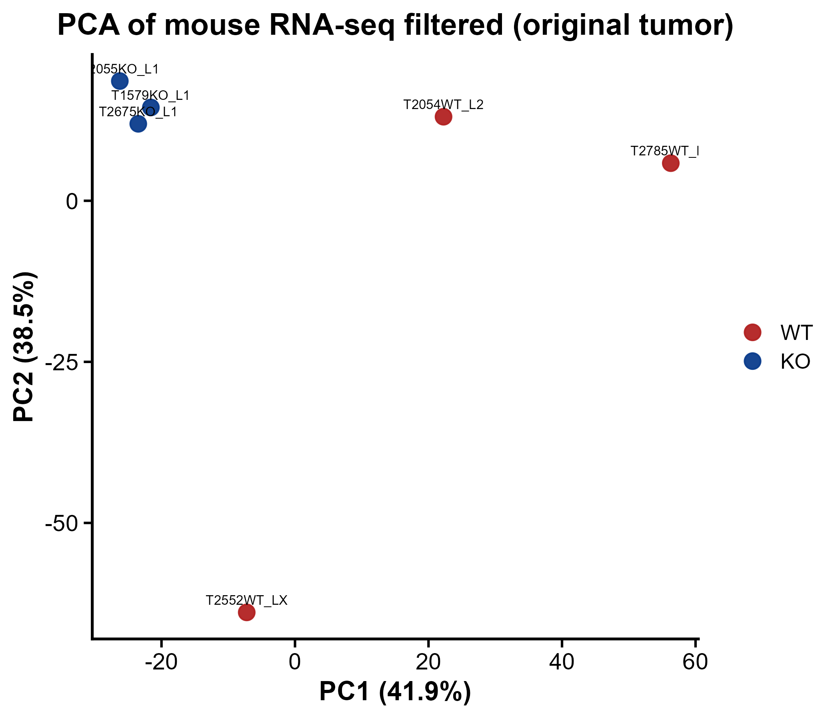
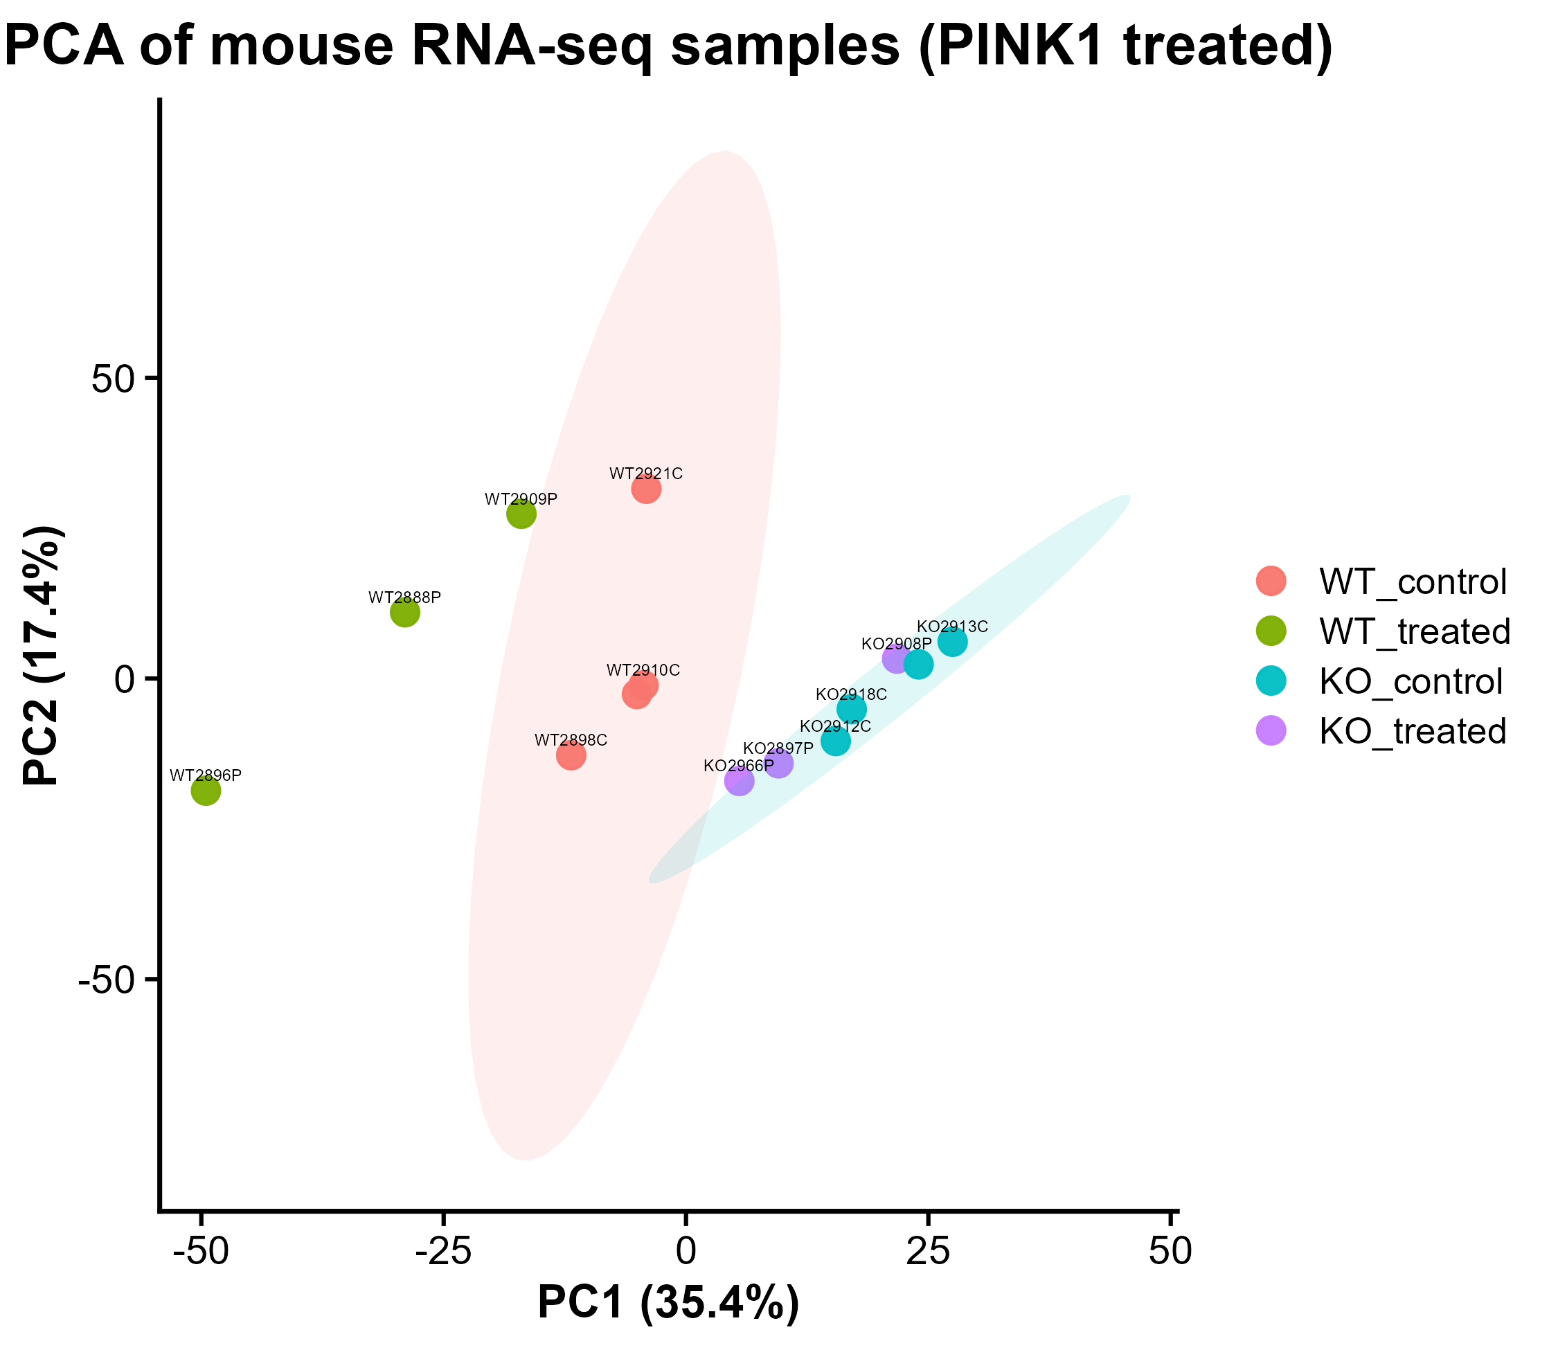
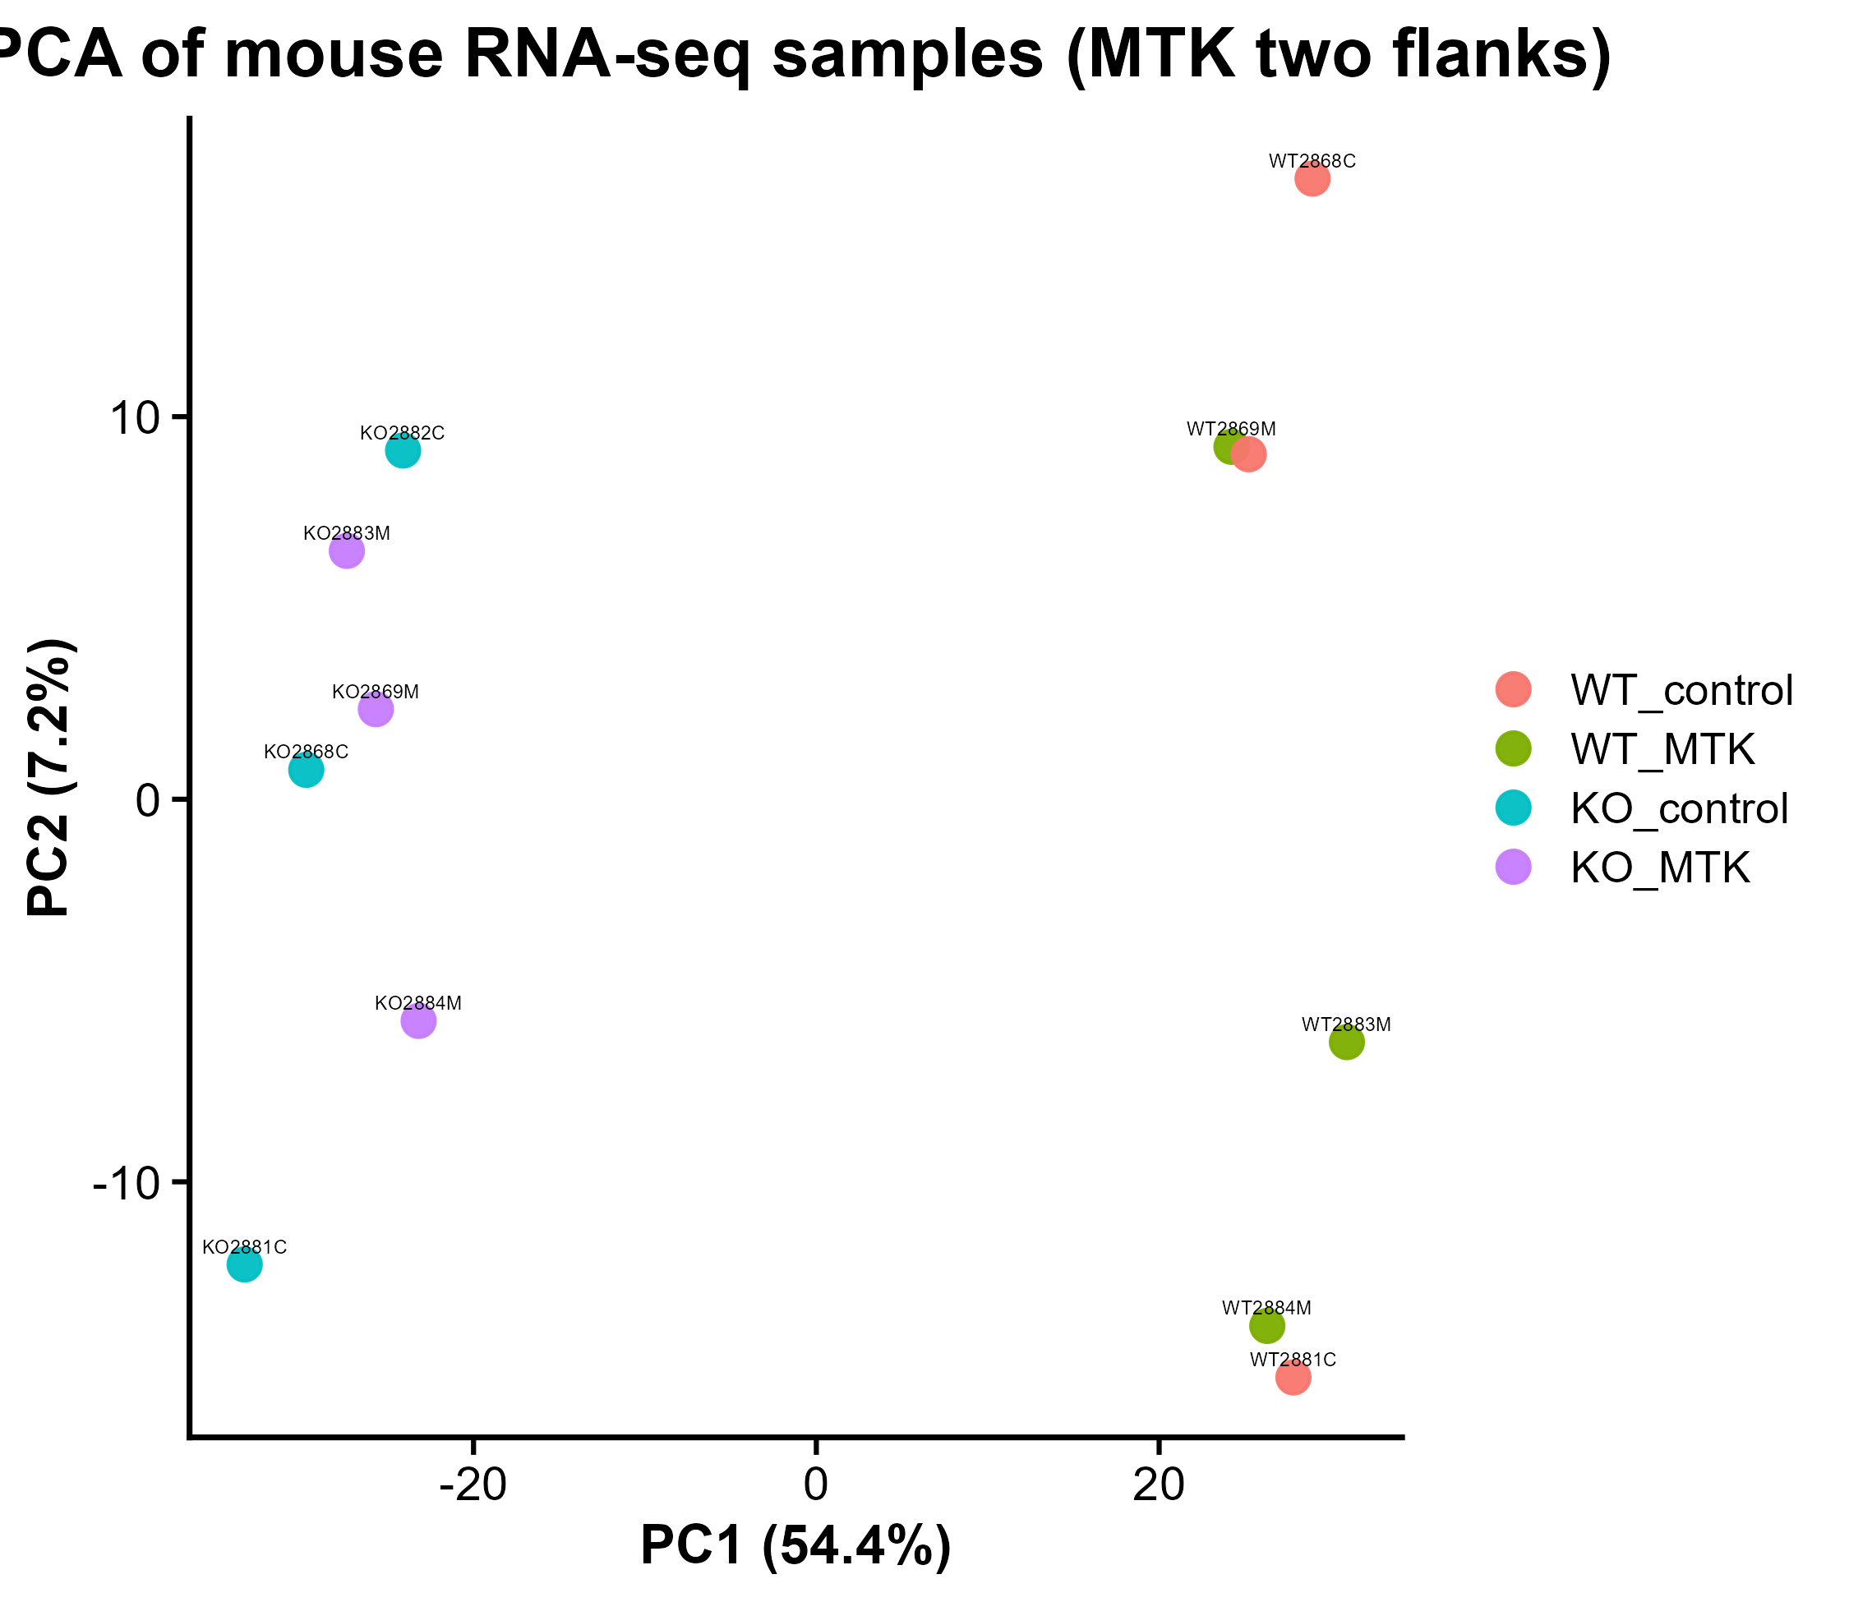
PCA Clustering of Sample Groups Across Treatment Collections
KO samples clustering more closely together.
WT samples are more dispersed: greater within-group variability
WT samples show separation based on treatment
KO samples cluster together regardless of treatment condition.
Sample separate mainly on genotype
Samples separate mainly based on genotype.
In both genotypes, treatment effect does not seem to affect the within group variance.

Slide 26
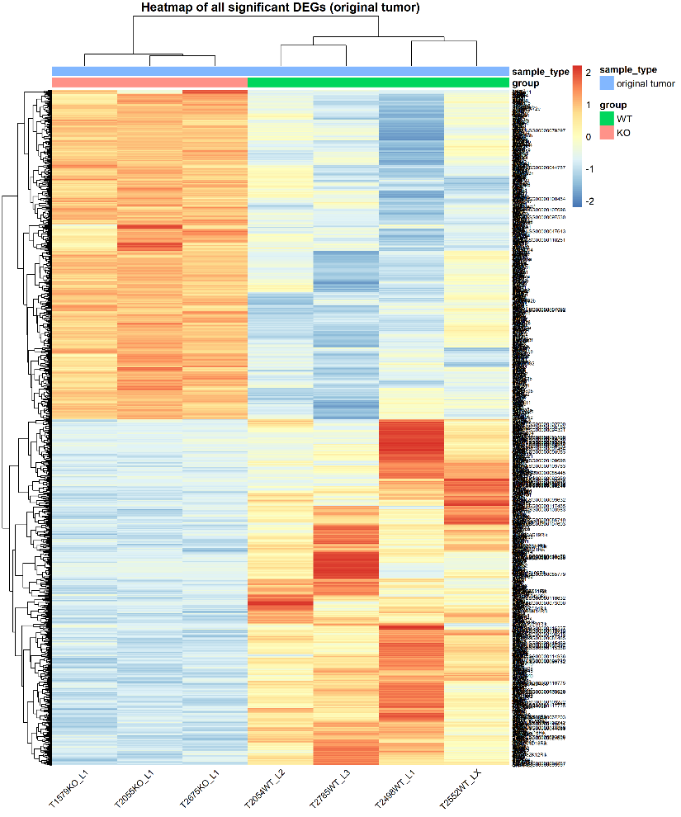
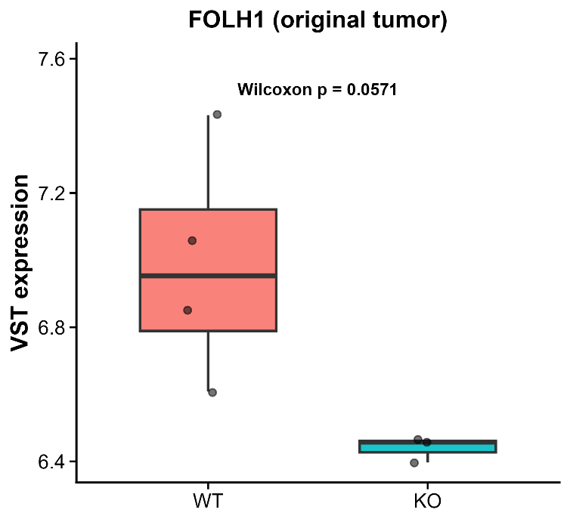
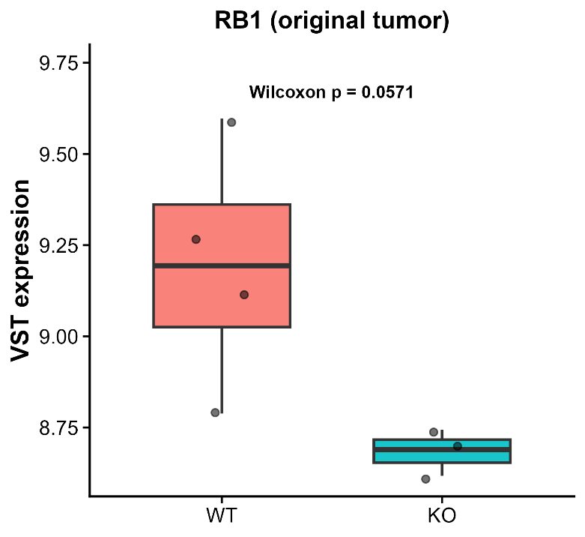
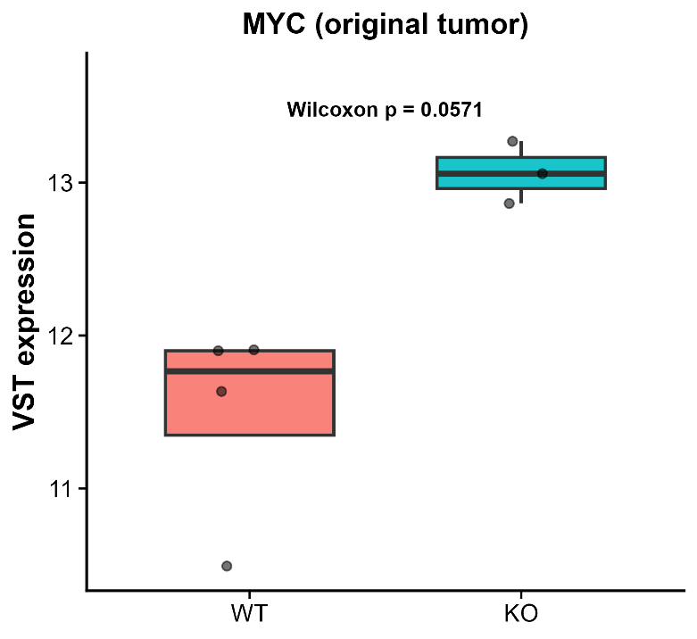
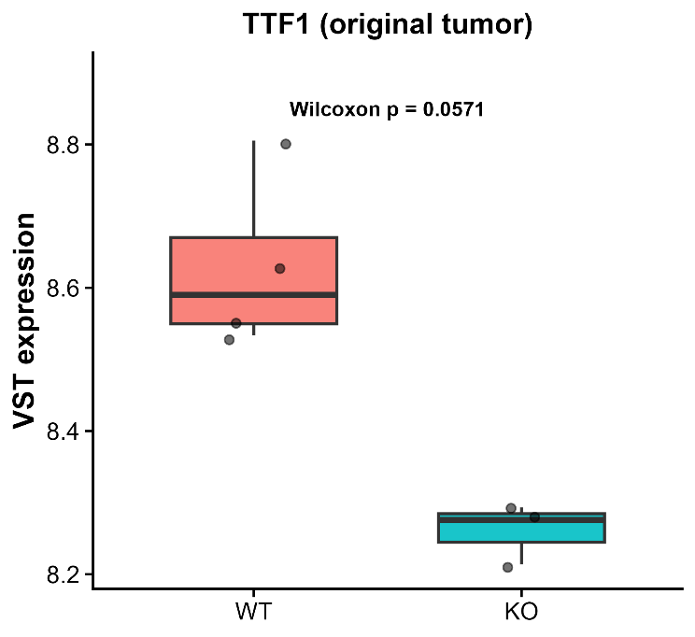
Original Tumor: Differential Expression Analysis, WT v KO
Heatmap shows clear separation between WT and KO samples
FOLH1, RB1 and TTF1 were lower in KO tumors, whereas MYC was higher
Changes in genes related to tumor identity and proliferation

Slide 27
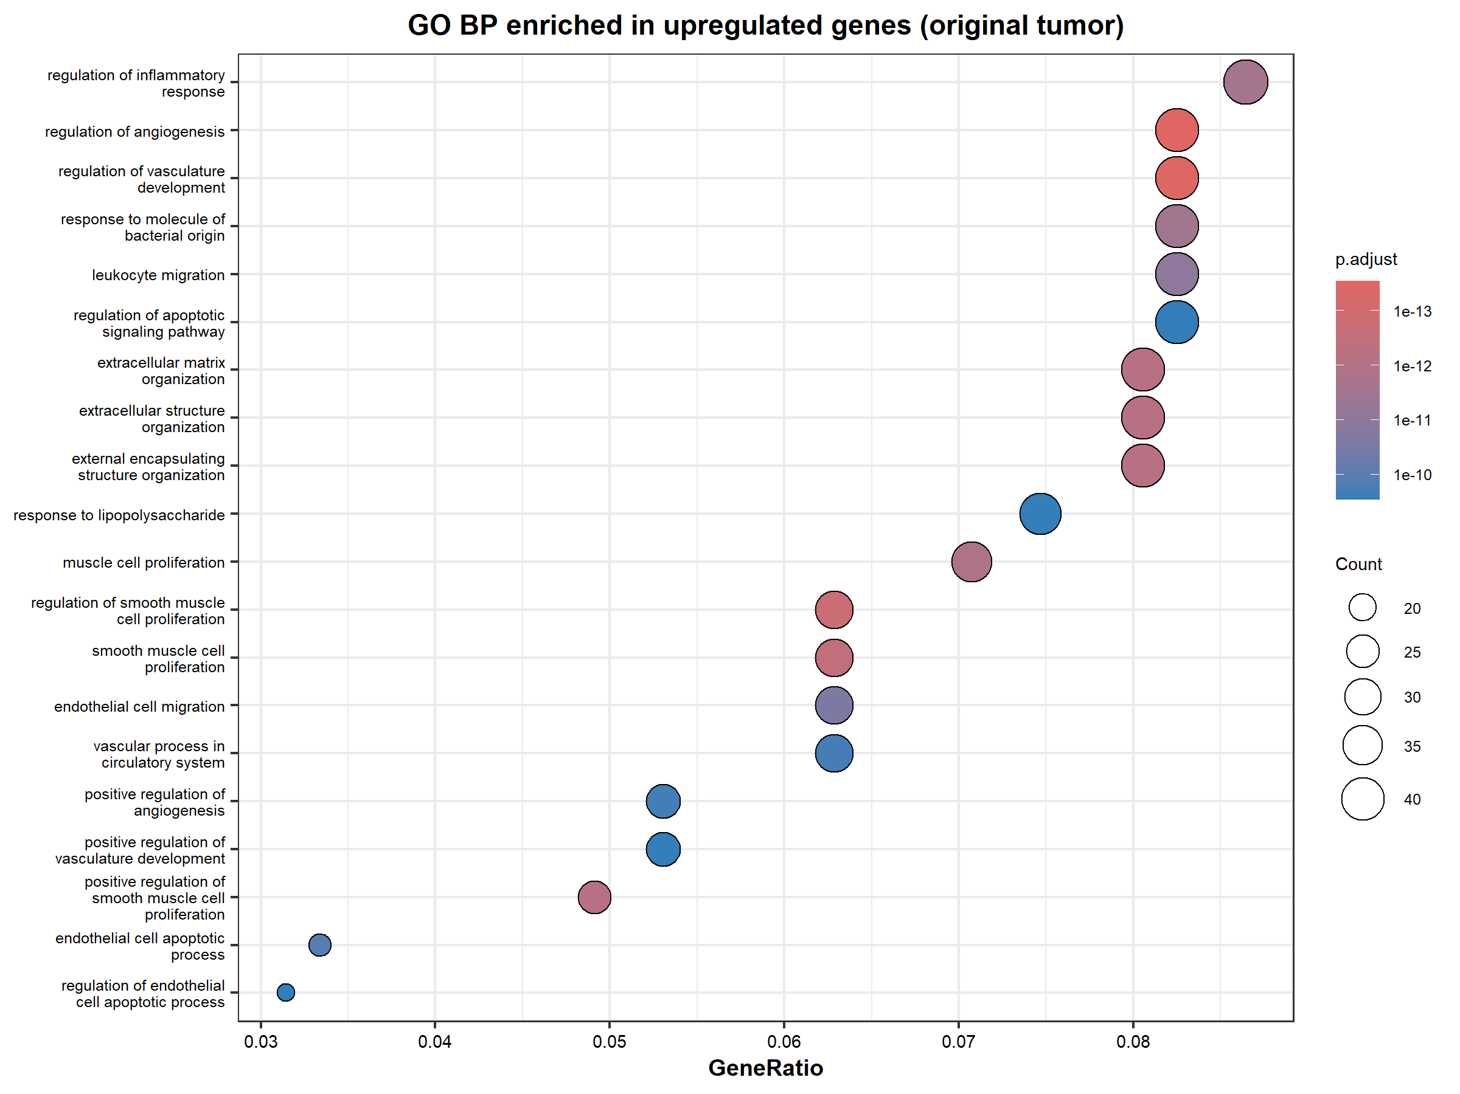
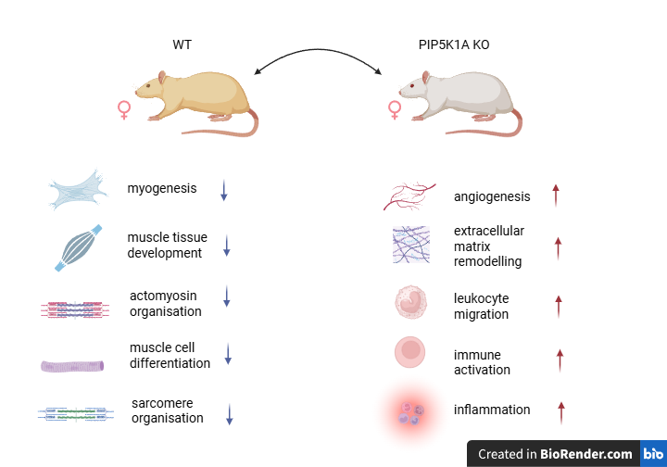
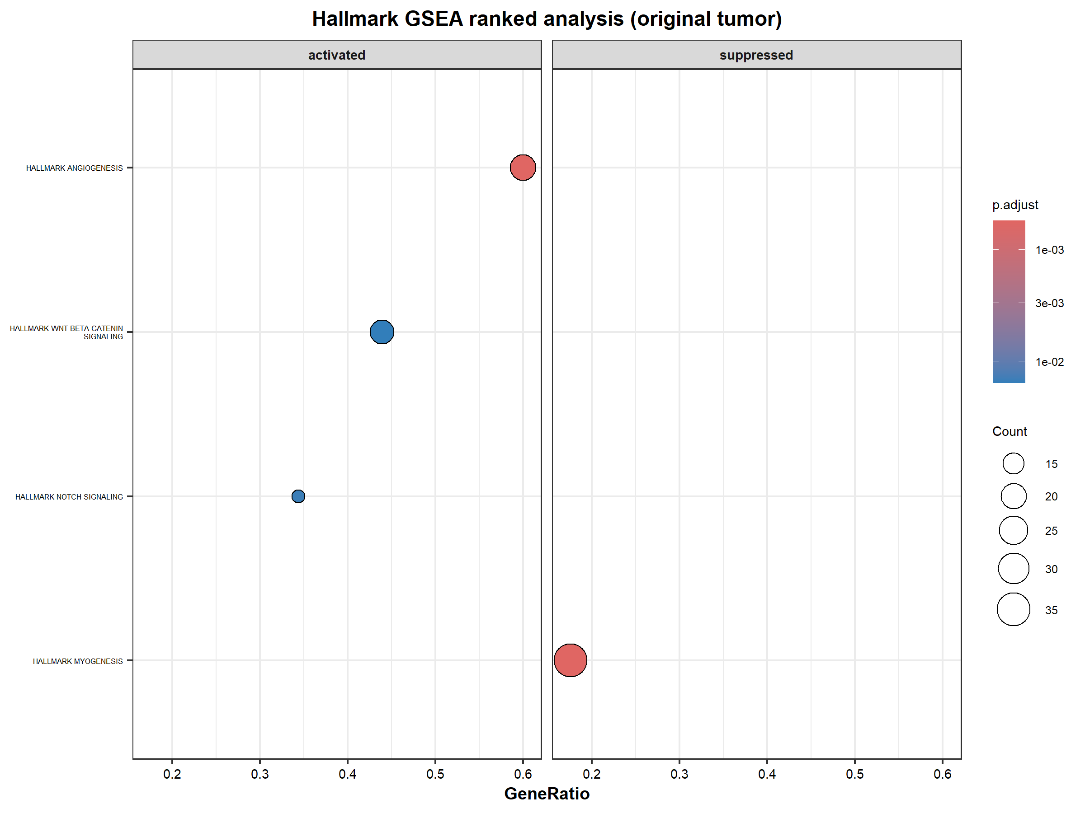
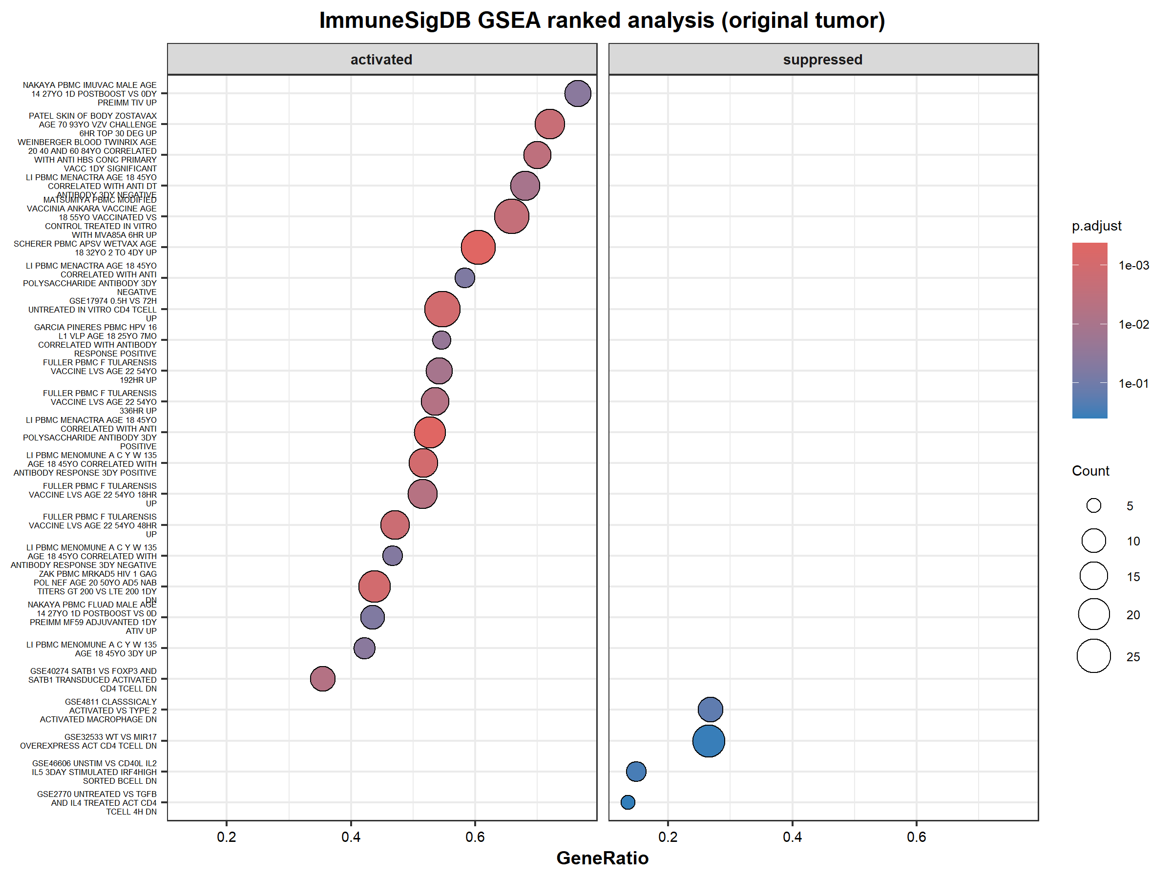
Pathway Enrichment Analysis
Results were combined from the following pathway analysis
Go BP Over Representative Analysis (ORA)
GSEA HALLMARK
GSEA ImmuneSigDB

Slide 28
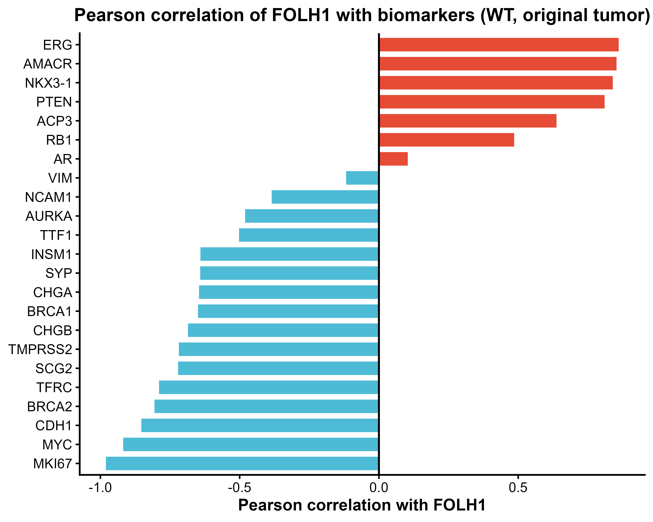
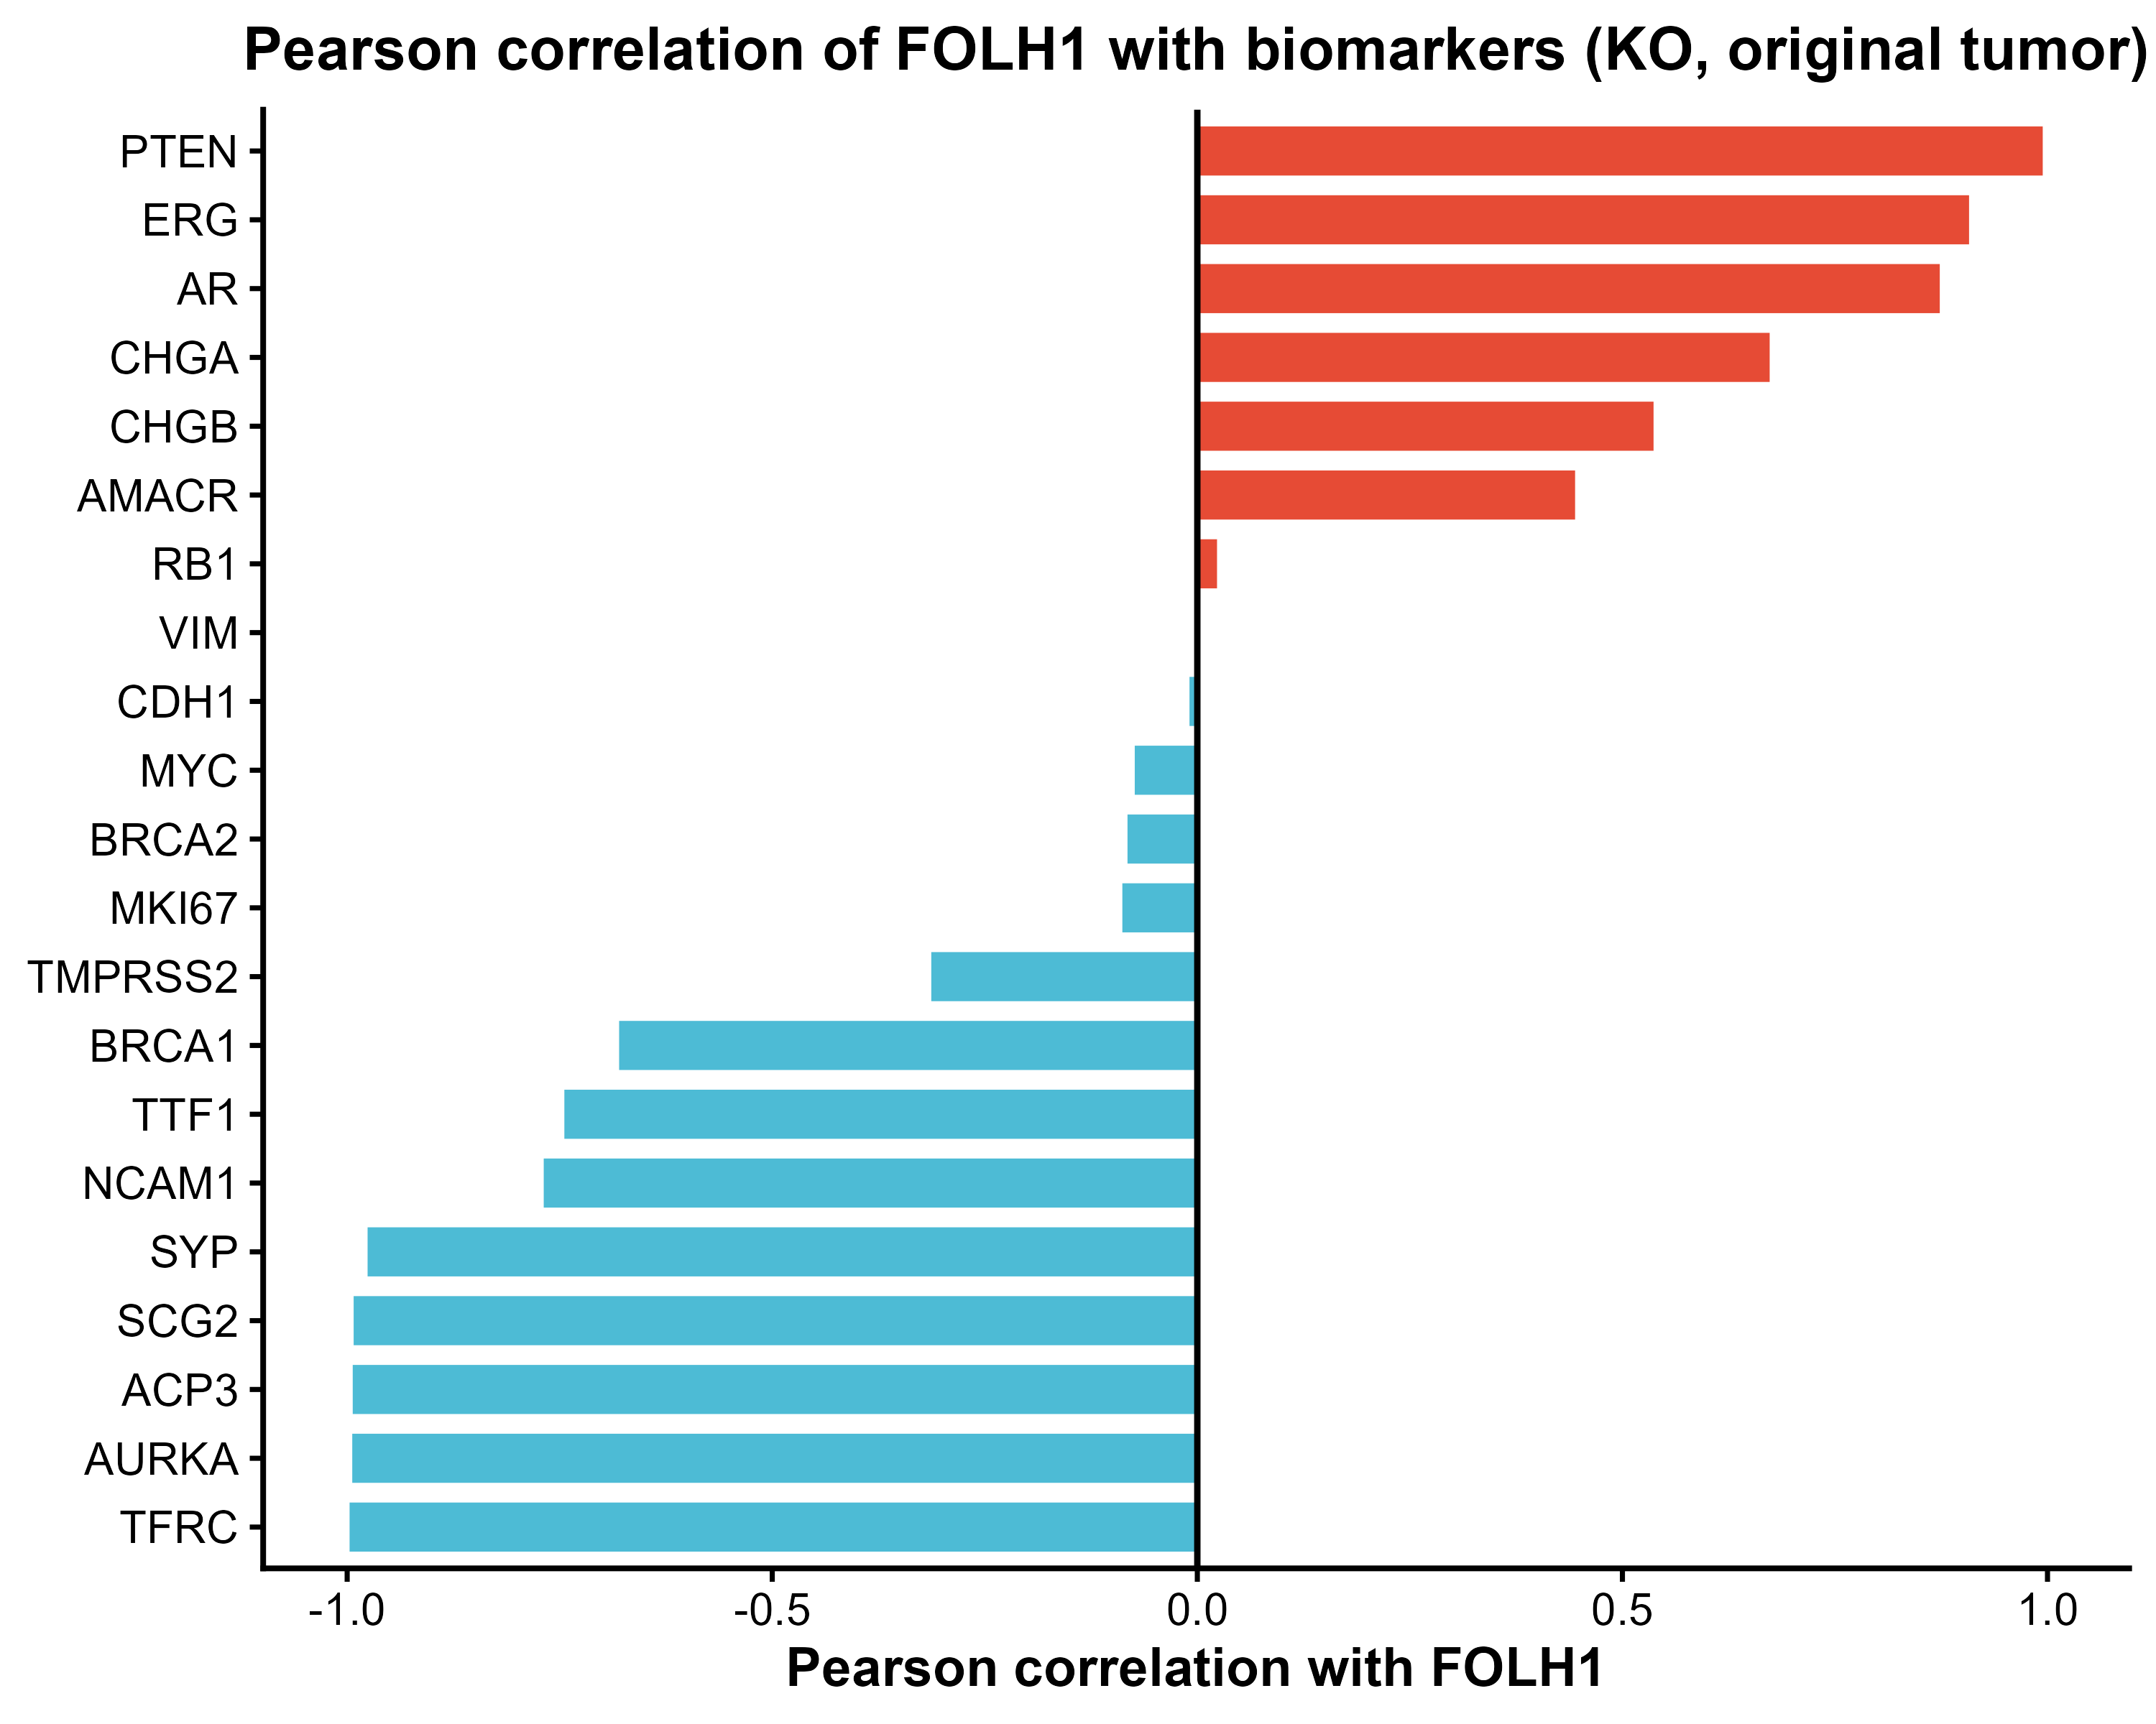
Correlation of PRAD Biomarkers with FOLH1 in original tumor mouse models
Chromogranin A & B both go from negative to strongly positive correlation in KO tumors
ACP3 goes from positive to strongly negative correlation in KO tumors

Slide 29



MCP counter groups with significant differences between WT and KO for PIP5K1A
Monocytes/macrophages, endothelial cells and vessels higher in KO
Consistent with the pathway enrichment analysis results
However, all comparisons were borderline and did not reach conventional statistical significance

Slide 30
Conclusions for PAAD
PIP5K1A- Pancreatic adenocarcinoma
Associated with selected immune-infiltration features
Inconsistent prognostic associations across PAAD subtypes
In mouse tumors, genotype produced stronger transcriptional separation than treatment
Knockout was associated with inflammatory, angiogenic, and ECM-remodeling programs
Limitations: retrospective cohorts, heterogeneous datasets, multiple testing, and limited experimental sample sizes

Slide 31
References
Adhikari, H., & Counter, C. M. (2018). Interrogating the protein interactomes of RAS isoforms identifies PIP5K1A as a KRAS-specific vulnerability. Nature communications, 9(1), 3646. https://doi.org/10.1038/s41467-018-05692-6
James ND, Tannock I, N’Dow J, Feng F, Gillessen S, Ali SA, et al. The Lancet Commission on prostate cancer: planning for the surge in cases. The Lancet, Published online 4 April 2024. https://doi.org/10.1016/S0140-6736(24)00651-2
Leiphrakpam, P. D., Chowdhury, S., Zhang, M., Bajaj, V., Dhir, M., & Are, C. (2025). Trends in the Global Incidence of Pancreatic Cancer and a Brief Review of its Histologic and Molecular Subtypes. Journal of gastrointestinal cancer, 56(1), 71. https://doi.org/10.1007/s12029-025-01183-2
Llorente, A., Arora, G. K., Murad, R., & Emerling, B. M. (2025). Phosphoinositide kinases in cancer: from molecular mechanisms to therapeutic opportunities. Nature reviews. Cancer, 25(6), 463–487. https://doi.org/10.1038/s41568-025-00810-1
Sarwar, M. (2018). The role of phosphatidylinositol 4-phosphate 5-kinase type І alpha (PIP5K1α) and utility of its inhibitor for targeting metastatic cancer. [Doctoral Thesis (compilation), Department of Translational Medicine]. Lund University, Faculty of Medicine.
Sung, H., Filho, A. M., Laversanne, M., Ferlay, J., Siegel, R. L., Soerjomataram, I., Jemal, A., & Bray, F. (2026). Global cancer statistics 2024: GLOBOCAN estimates of incidence and mortality worldwide for 34 cancers in 186 countries. CA: a cancer journal for clinicians, 76(4), e70090. https://doi.org/10.3322/caac.70090
Zhang, R., Zhou, J., Dong, S., Liu, G., & Wei, X. (2026). Integrated computational and experimental analysis explores FOLH1 expression patterns across cancers and nominates melatonin as a potential modulator in prostate cancer models. PLOS Computational Biology, 22(5), e1014315. https://doi.org/10.1371/journal.pcbi.1014315

Slide 32
Thank You!

